Slide 1
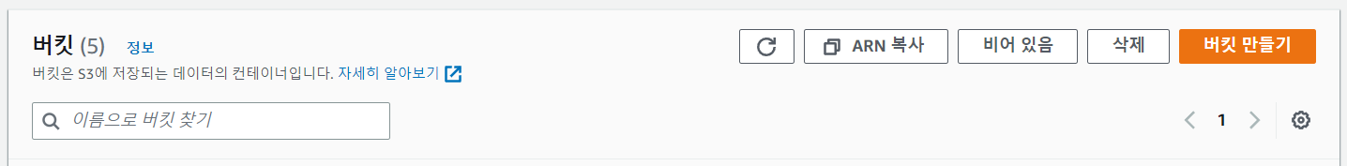

Slide 2
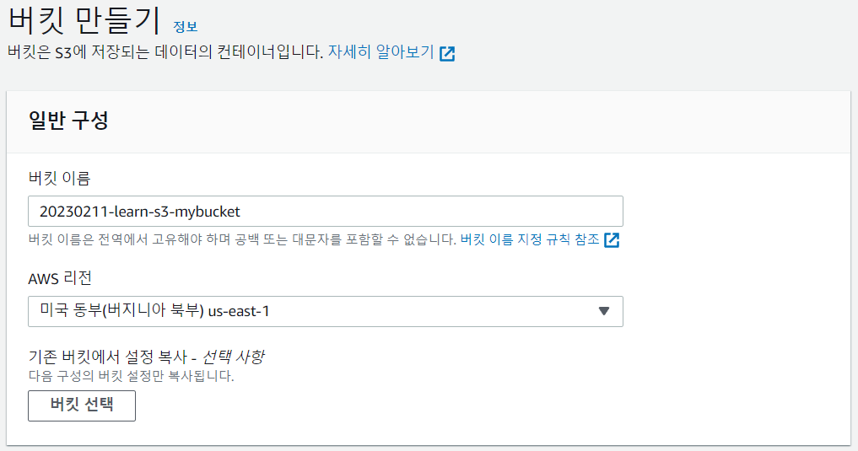
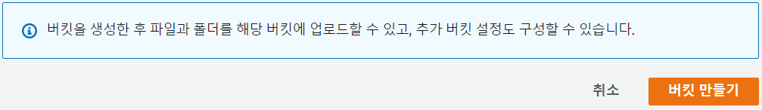

Slide 3
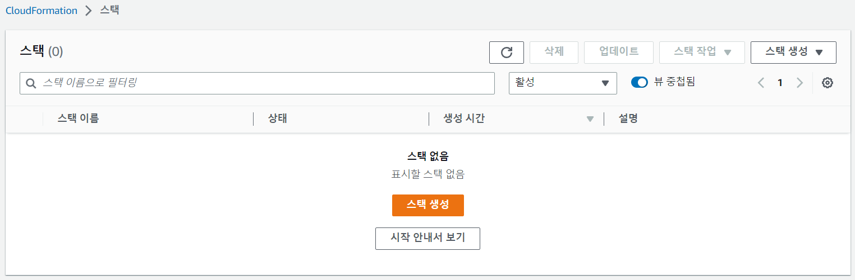

Slide 4
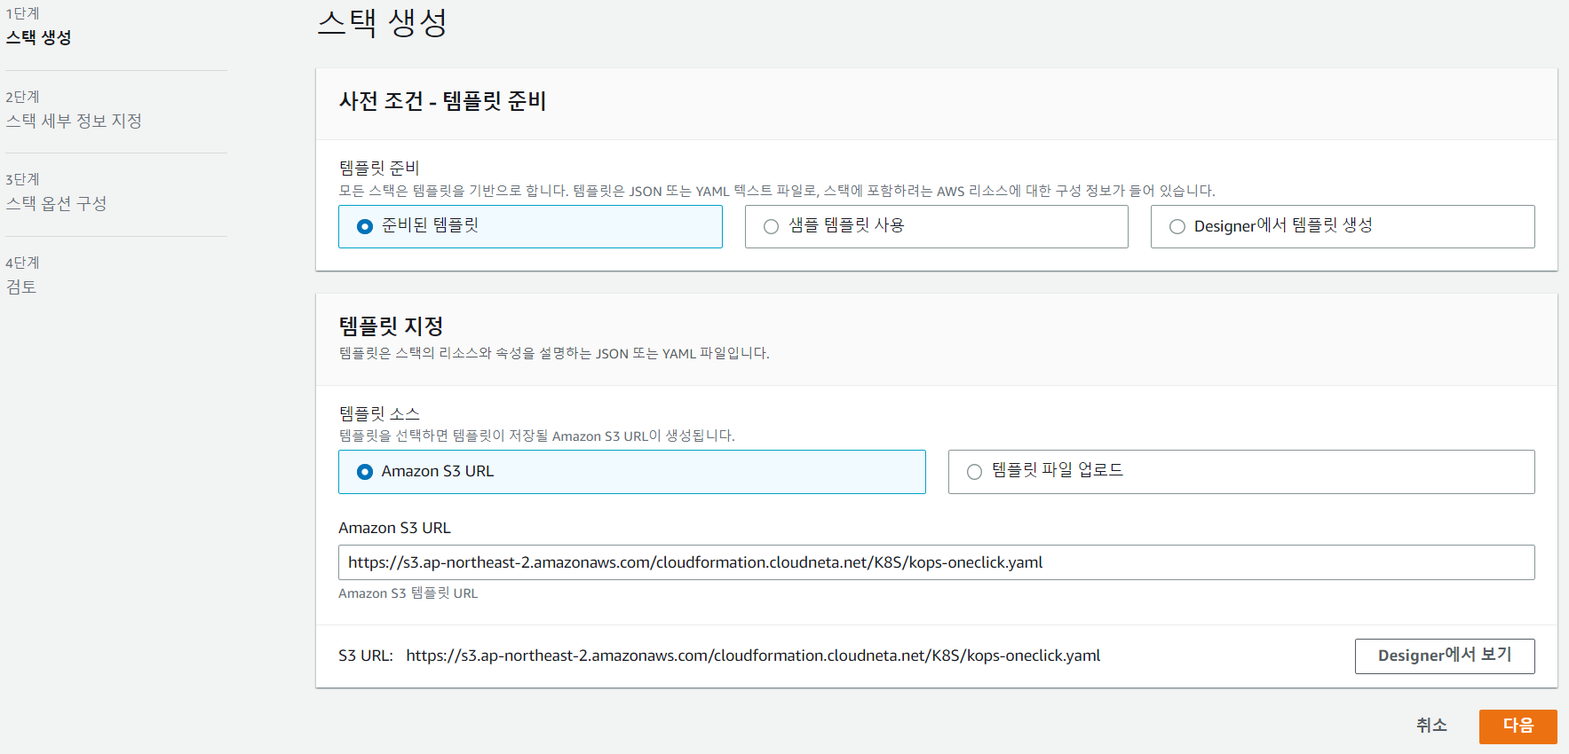

Slide 5
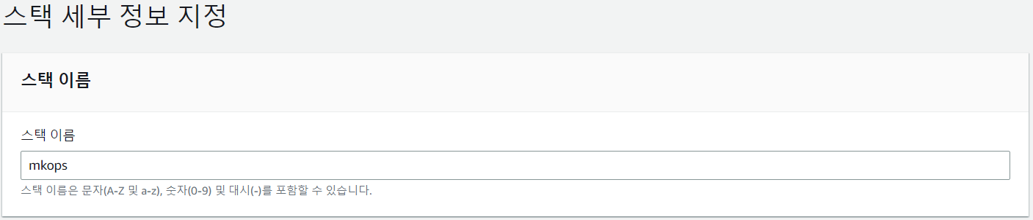

Slide 6
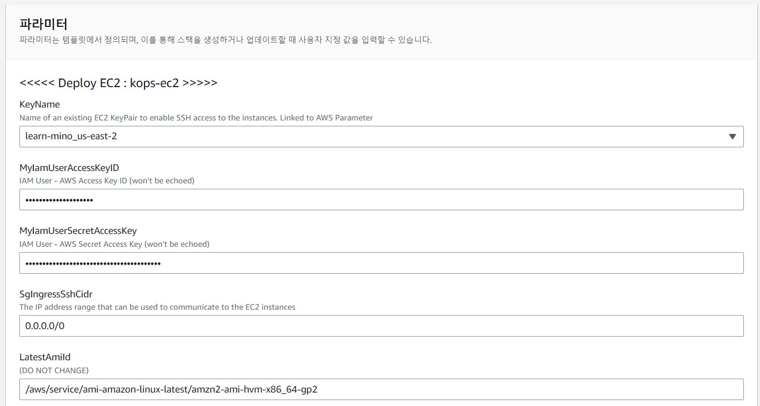

Slide 7
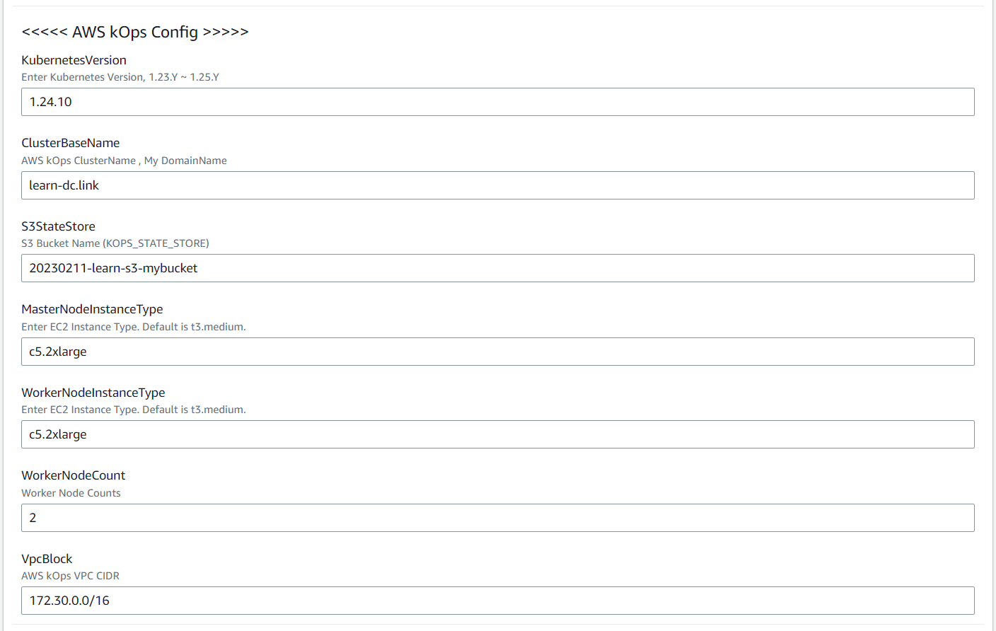

Slide 8
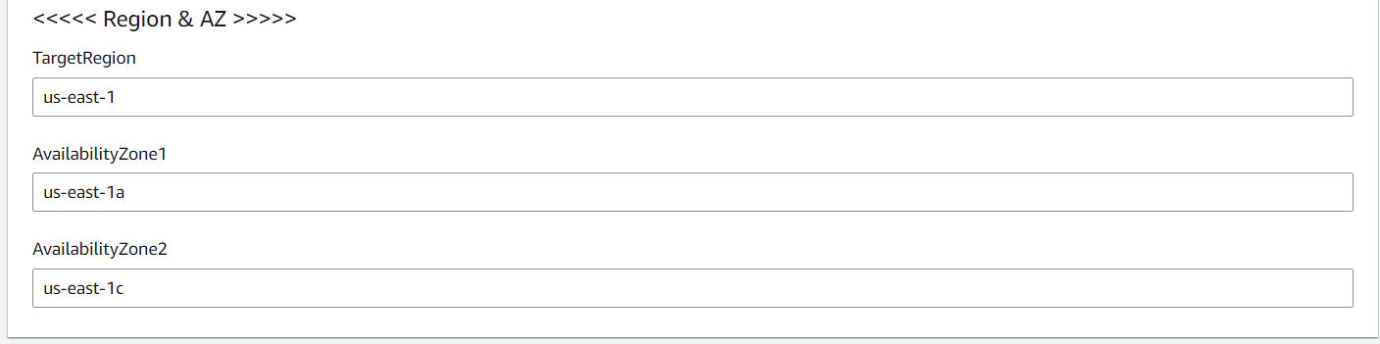

Slide 10
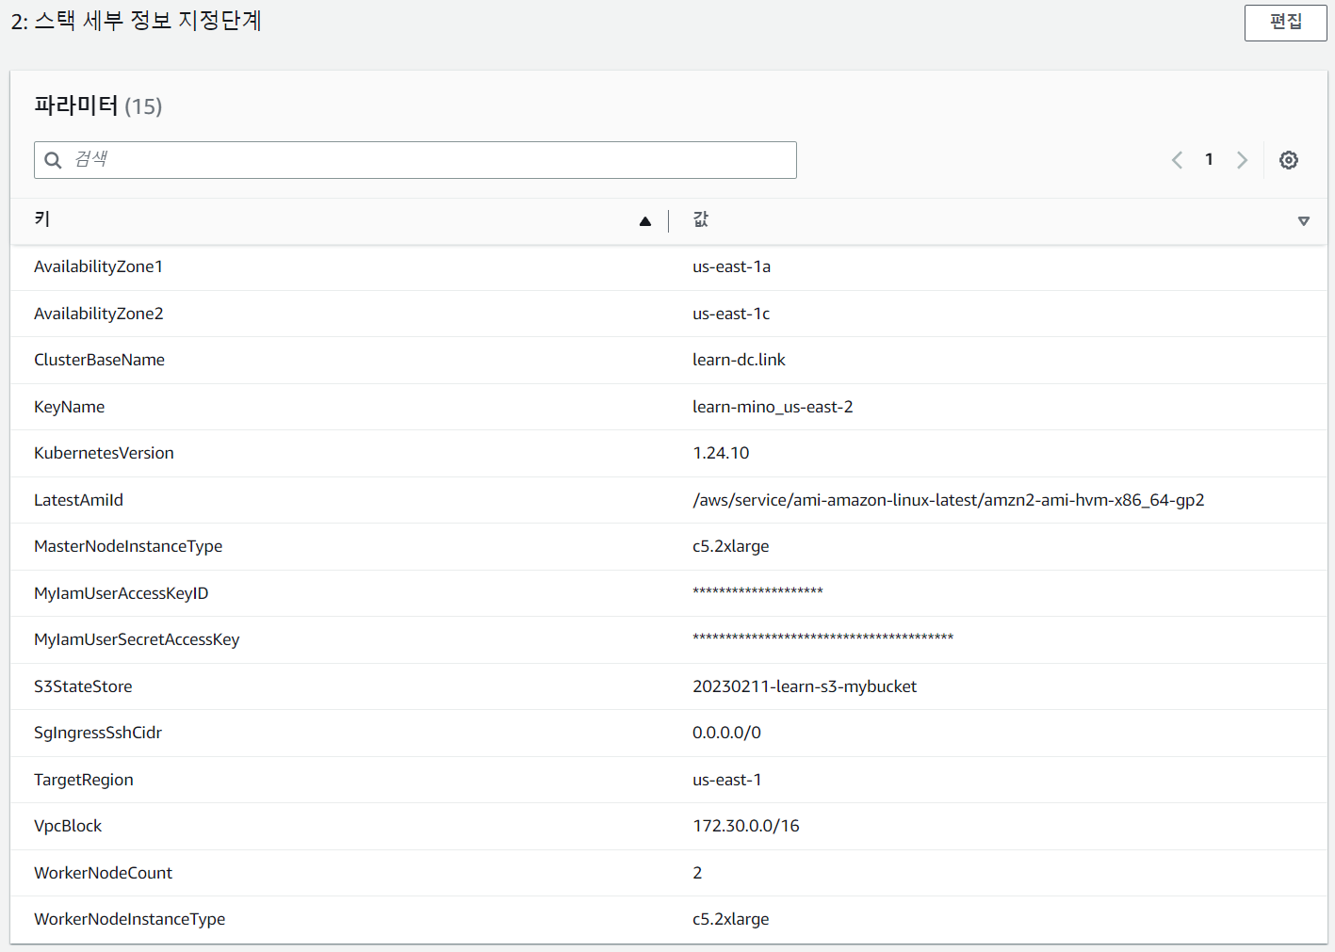

Slide 12
https://us-east-1.console.aws.amazon.com/cloudformation/home?region=us-east-1#/stacks/quickcreate?templateURL=https%3A%2F%2Fs3.ap-northeast-2.amazonaws.com%2Fcloudformation.cloudneta.net%2FK8S%2Fkops-oneclick.yaml&stackName=mkops&param_KubernetesVersion=1.24.10&param_TargetRegion=us-east-1&param_AvailabilityZone1=us-east-1a&param_AvailabilityZone2=us-east-1c&param_WorkerNodeCount=2&param_LatestAmiId=%2Faws%2Fservice%2Fami-amazon-linux-latest%2Famzn2-ami-hvm-x86_64-gp2&param_VpcBlock=172.30.0.0%2F16&param_ClusterBaseName=learn-dc.link&param_KeyName=learn-mino_us-east-2&param_S3StateStore=20230203-learn-s3-mybucket&param_SgIngressSshCidr=0.0.0.0%2F0&param_WorkerNodeInstanceType=c5d.large&param_MasterNodeInstanceType=c5d.large

Slide 13
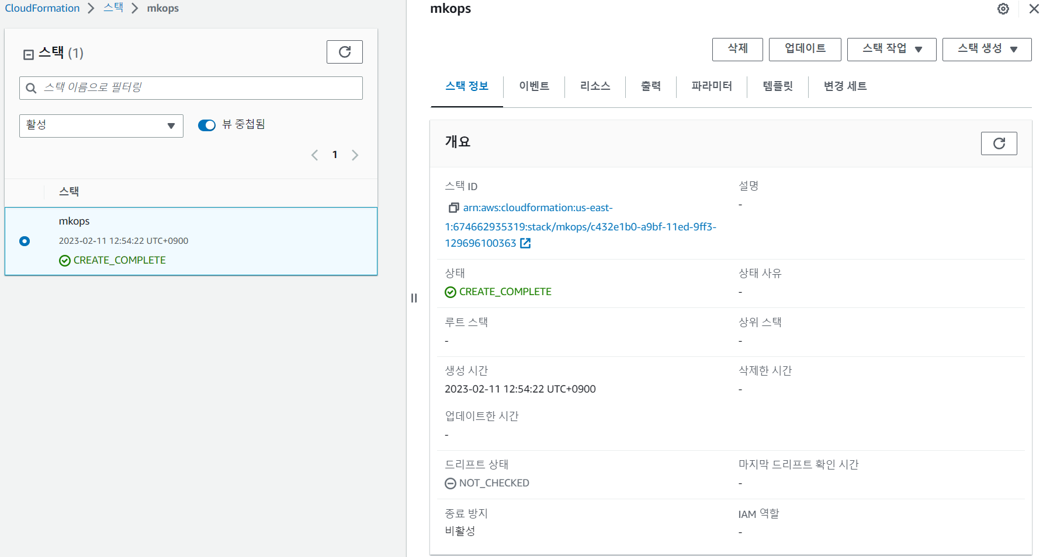

Slide 14
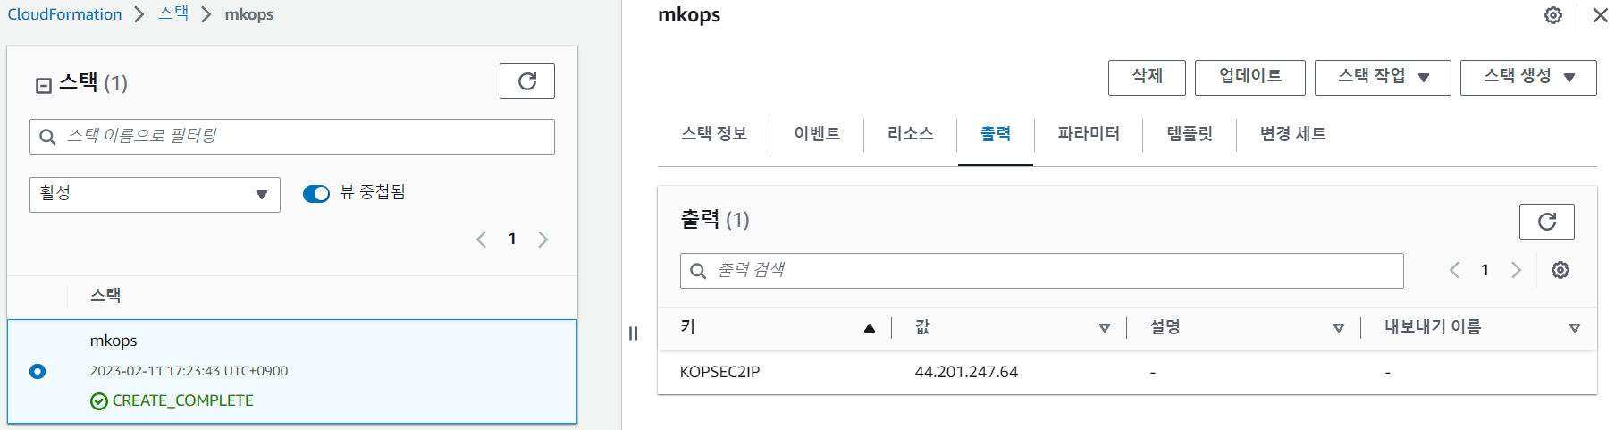

Slide 17
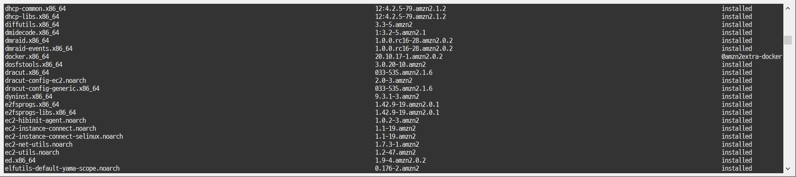

Slide 18
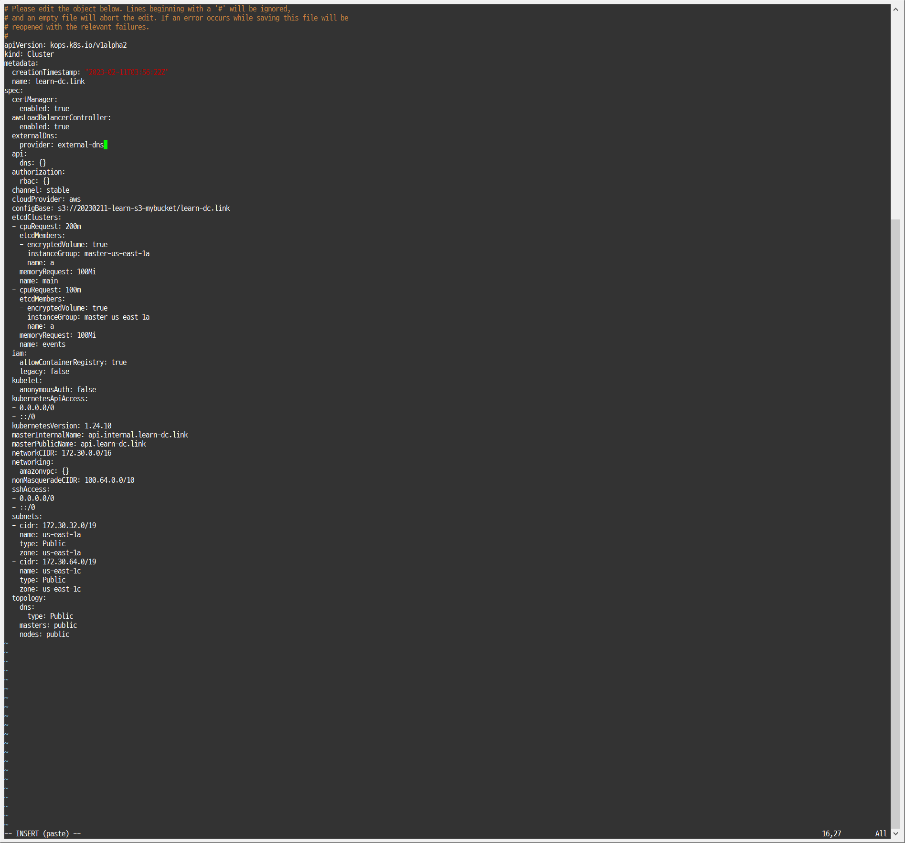

Slide 20
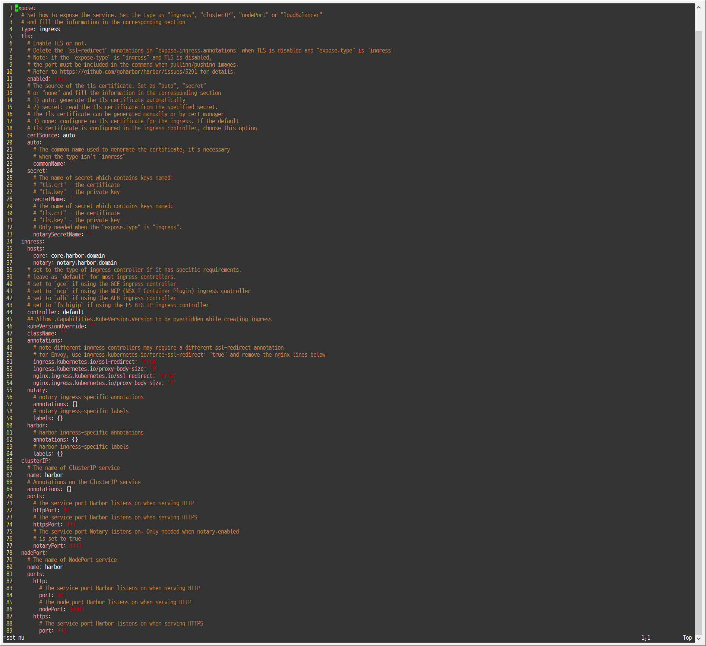

Slide 21
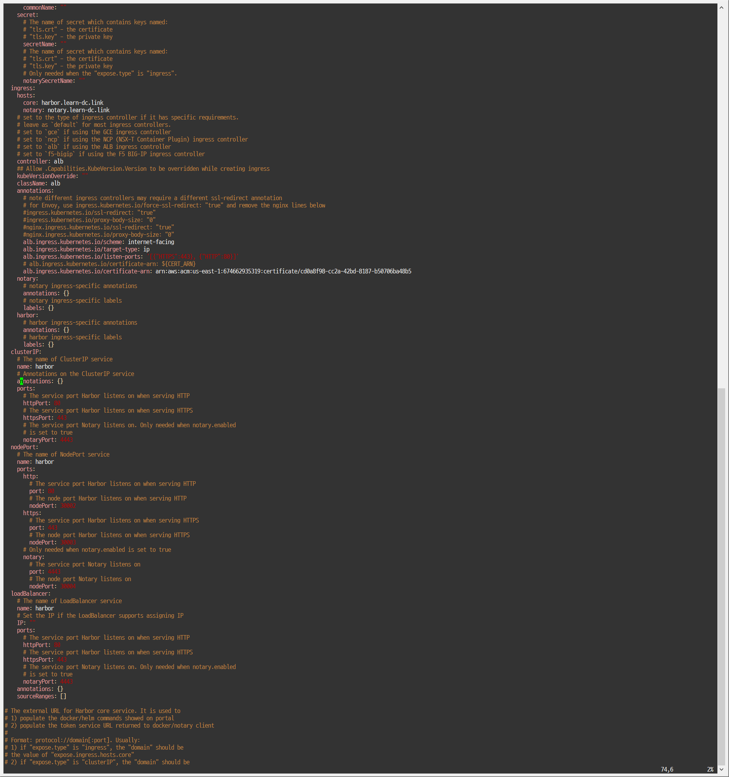

Slide 22
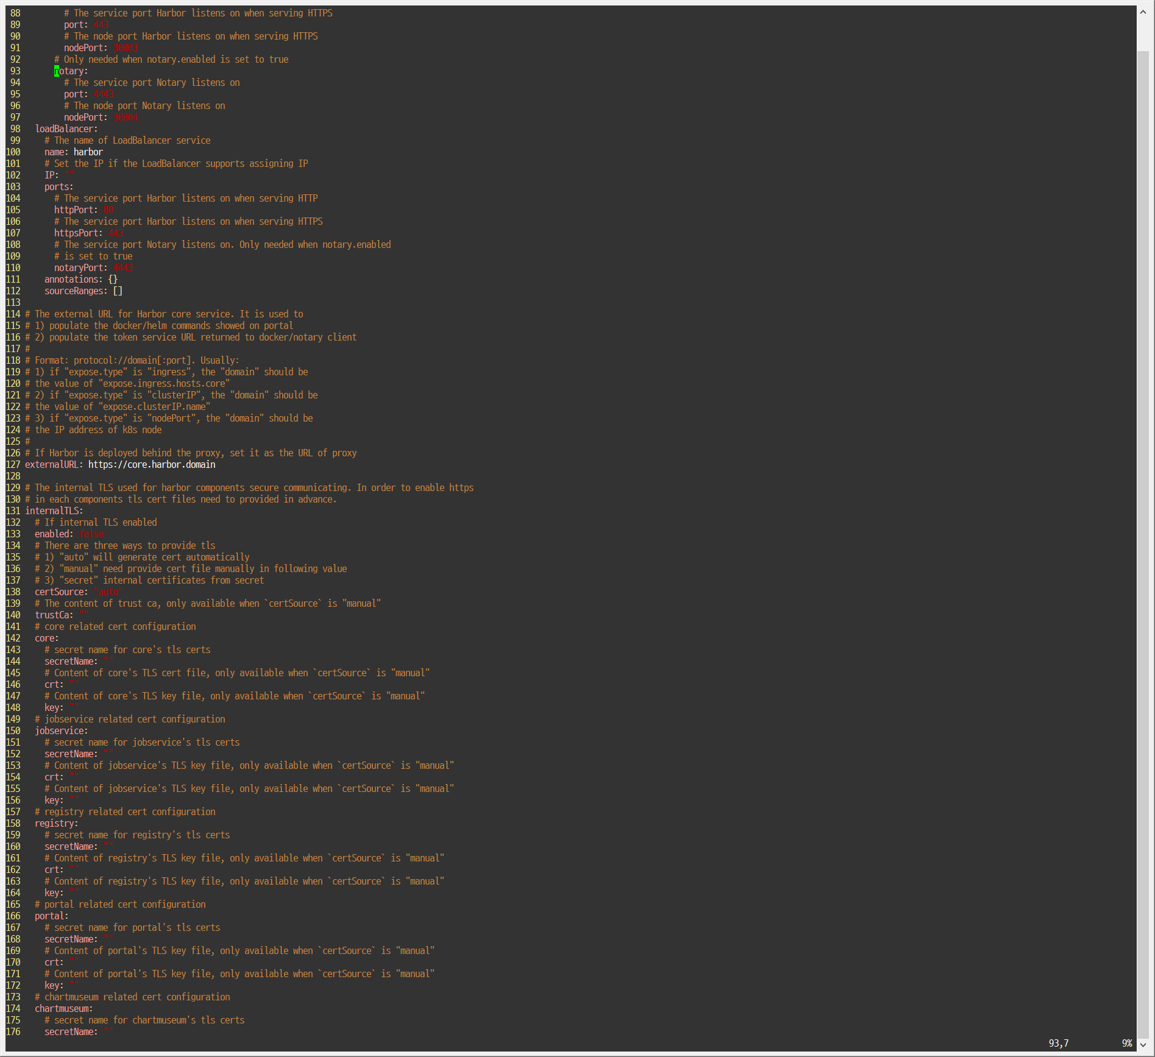

Slide 24
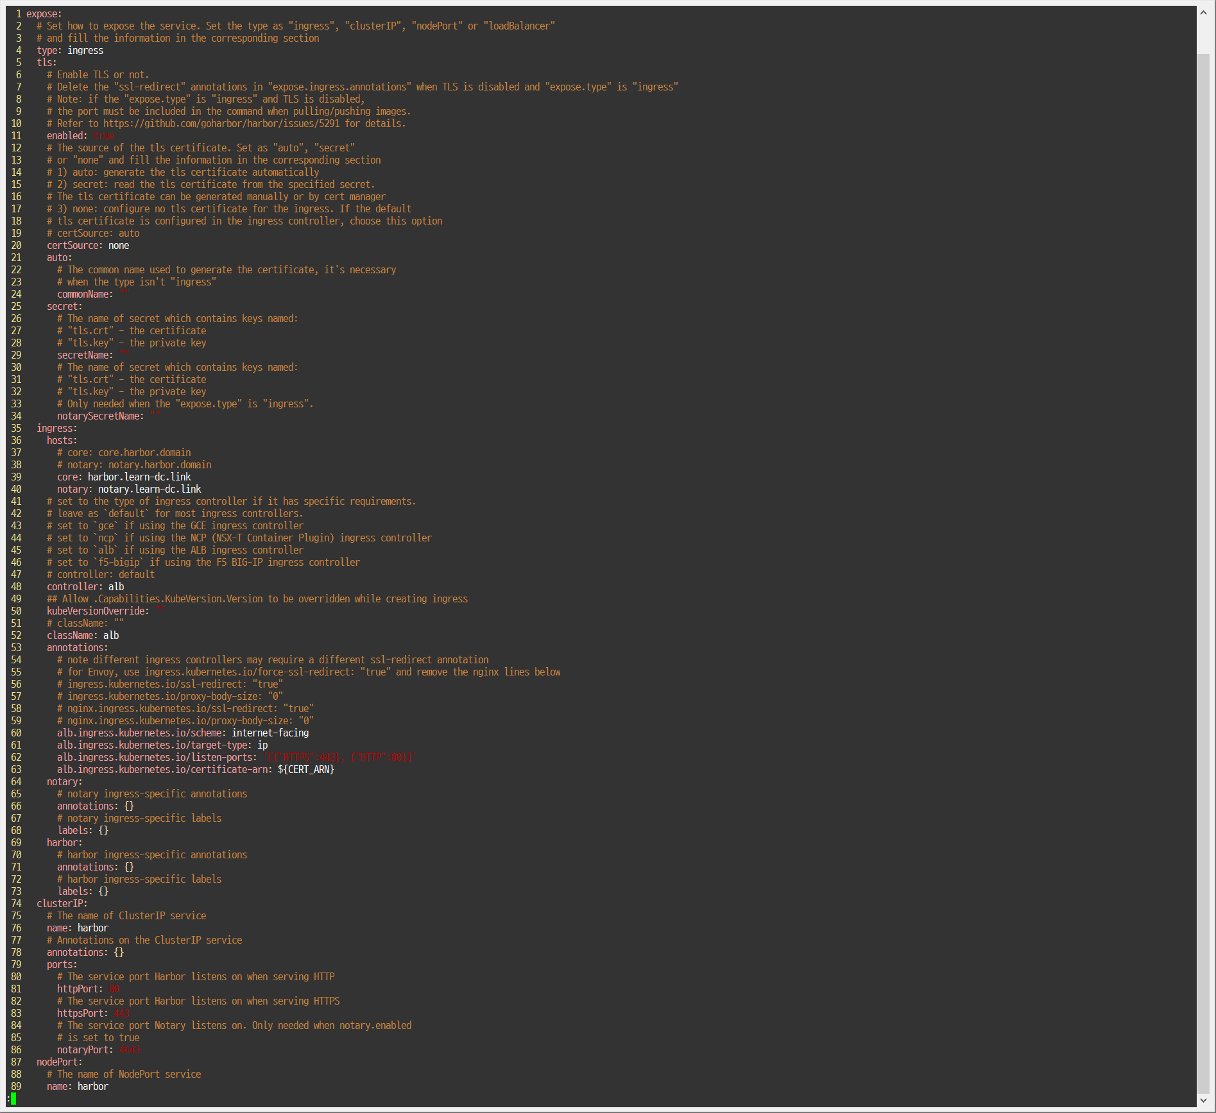

Slide 25
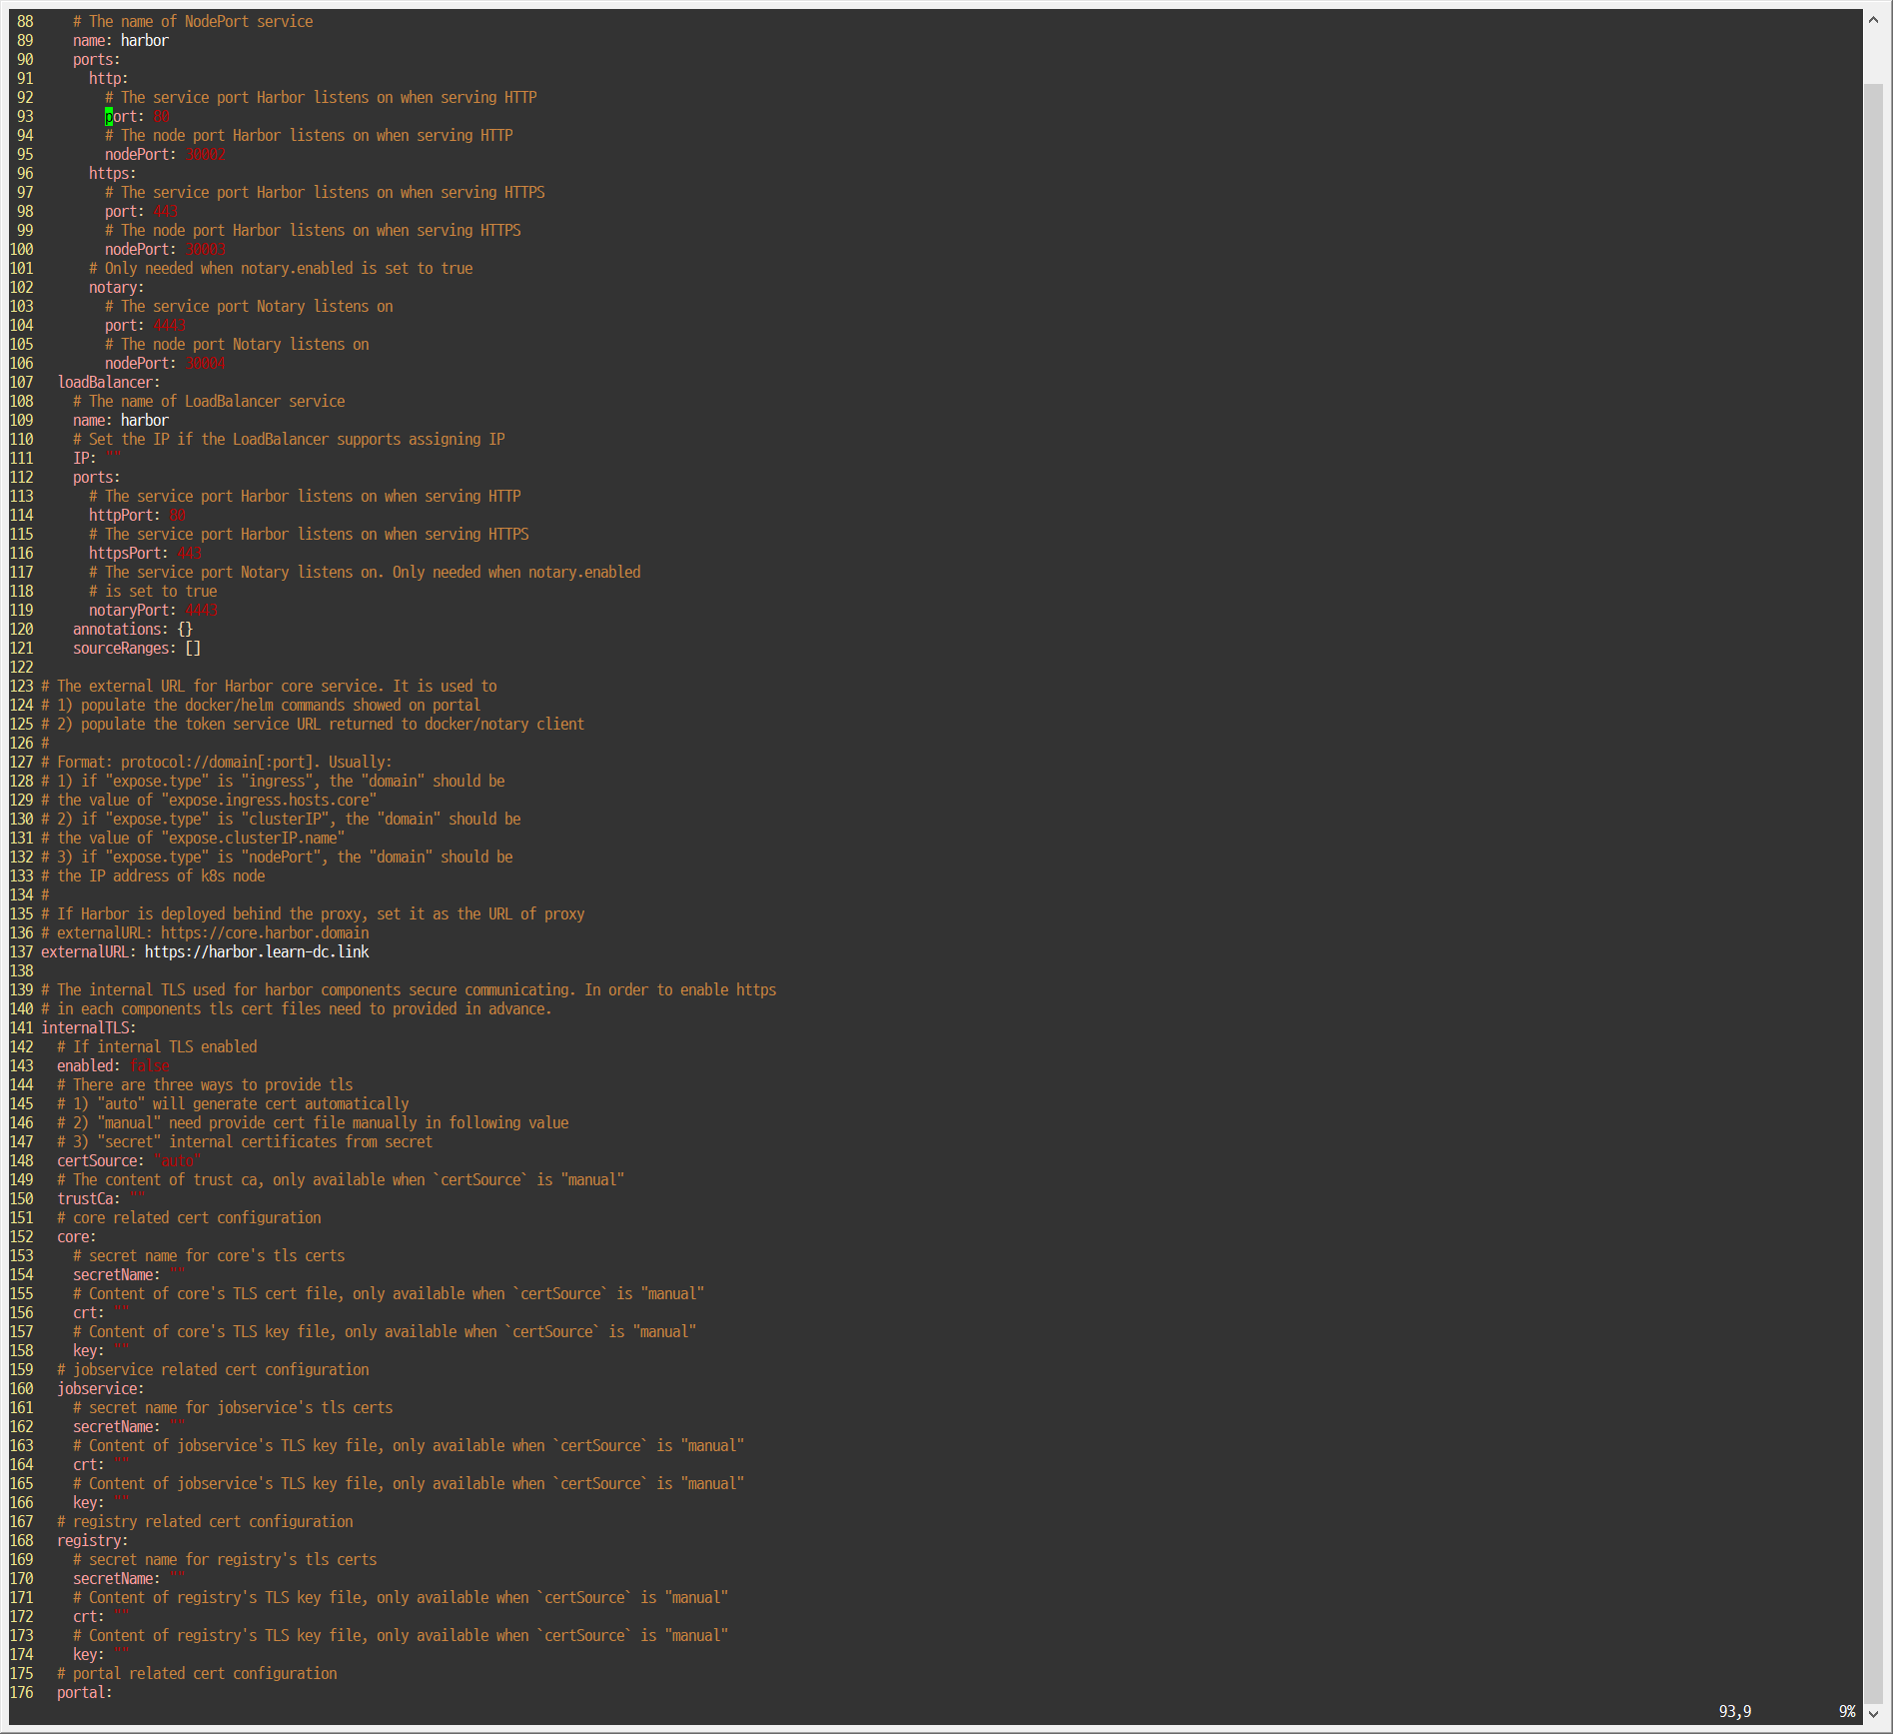

Slide 28
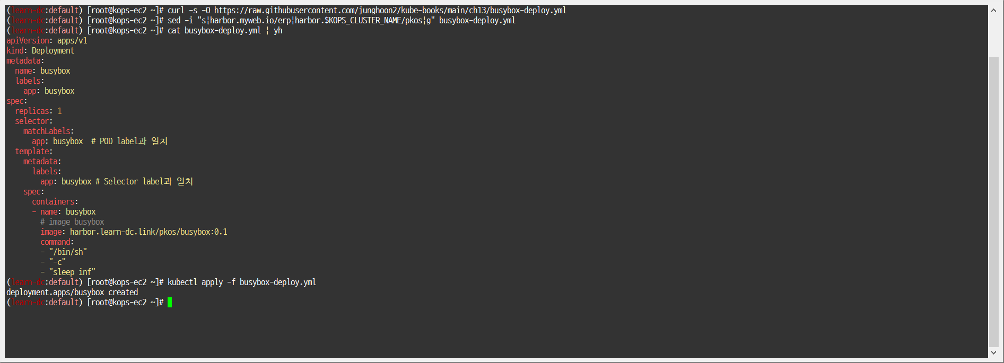

Slide 29
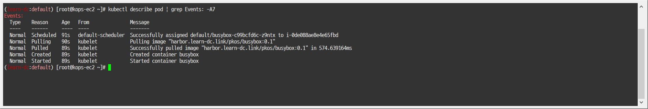

Slide 31
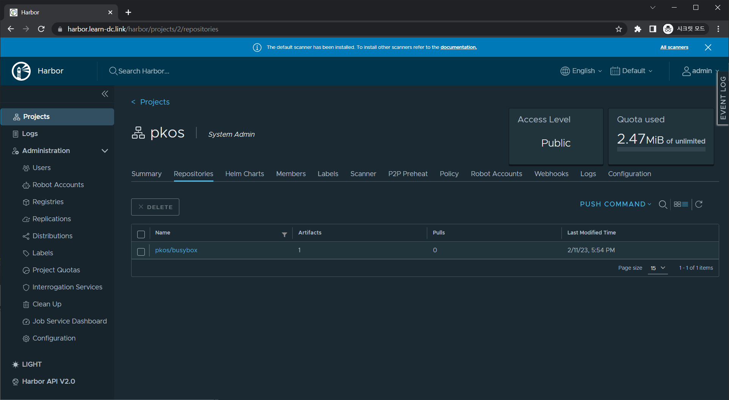

Slide 32
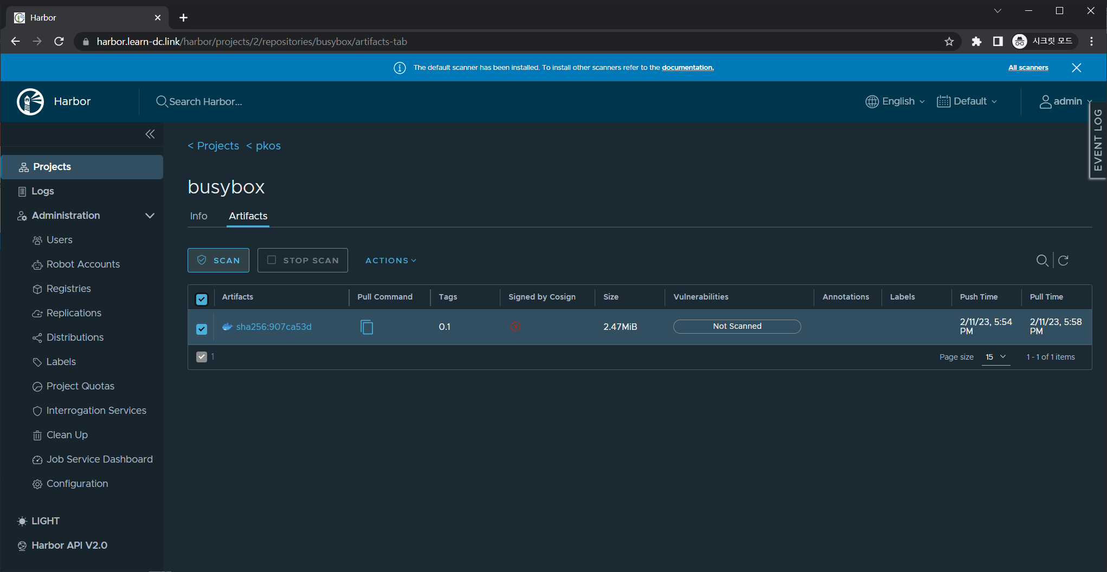

Slide 33
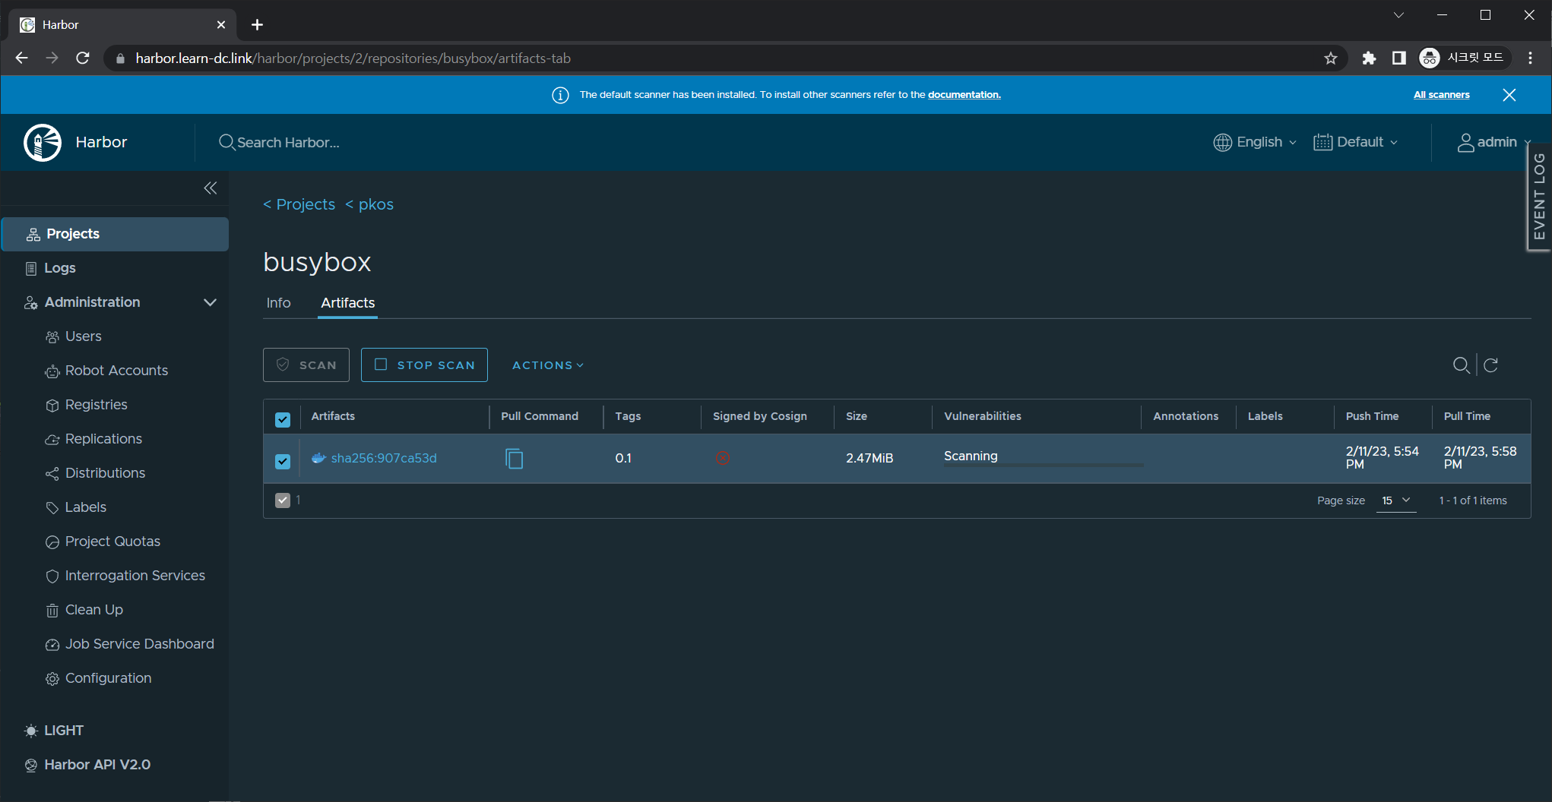

Slide 34
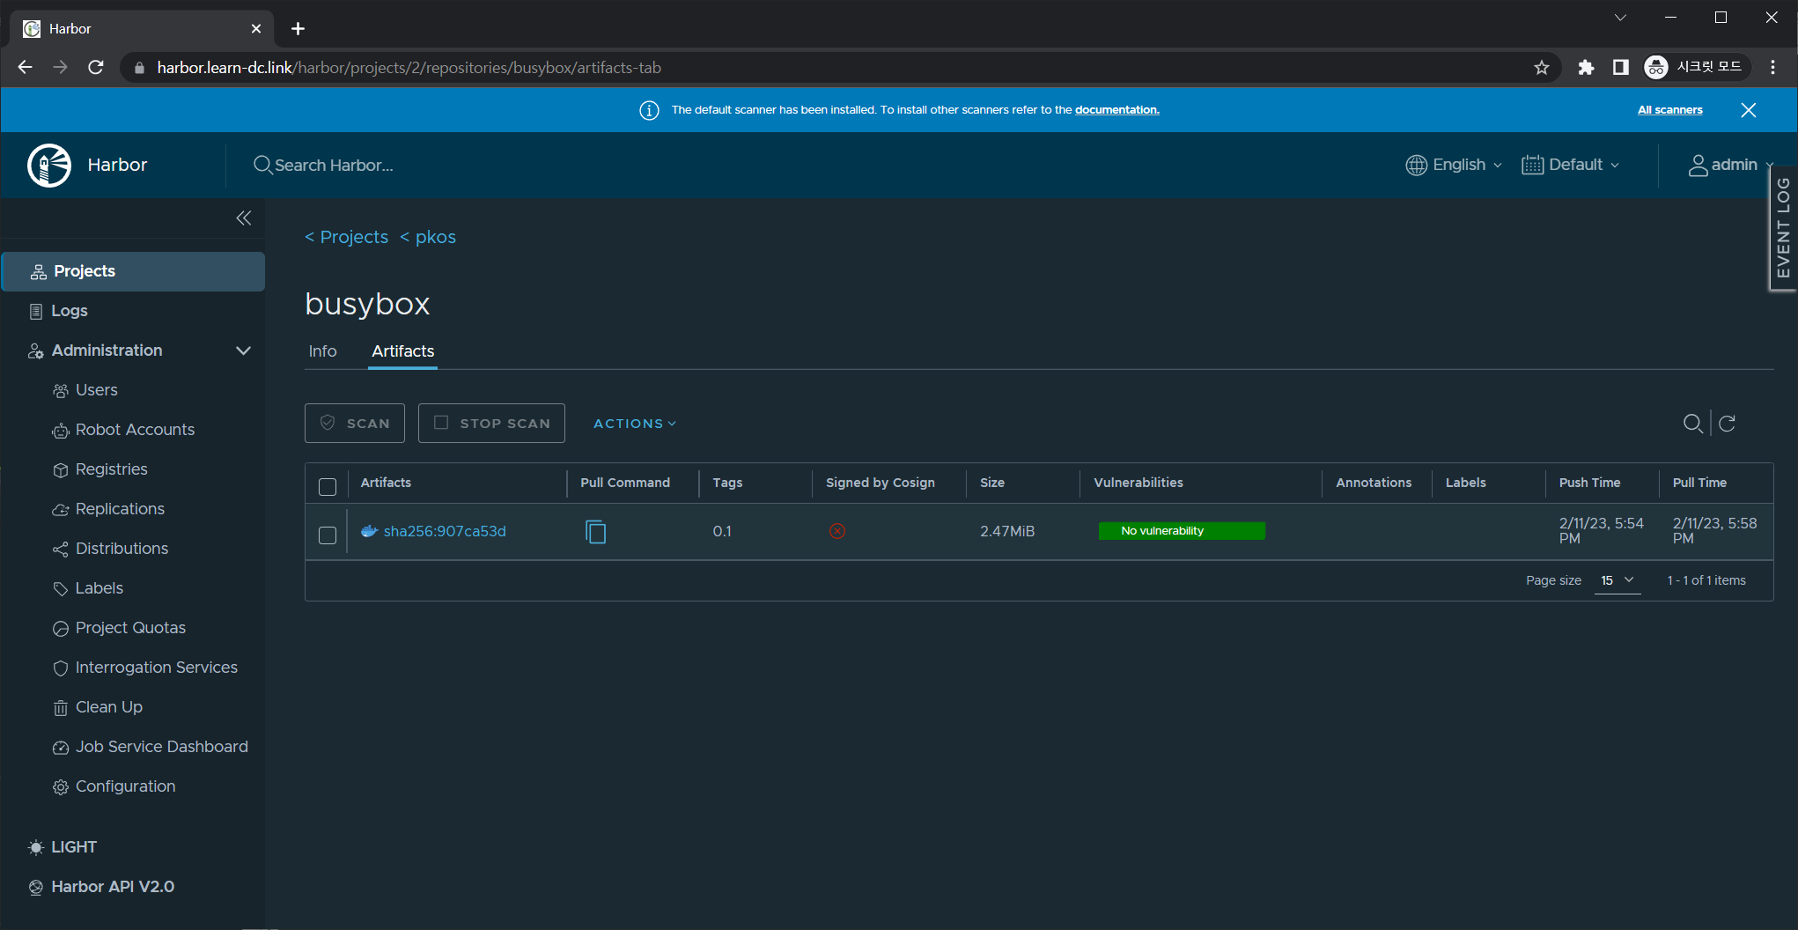

Slide 37
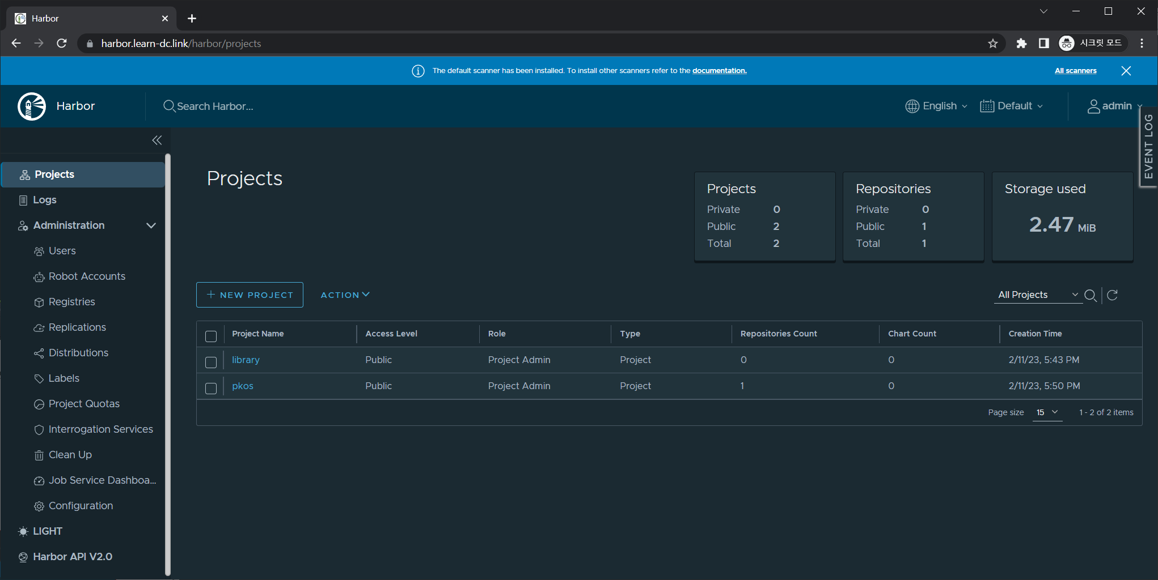

Slide 38
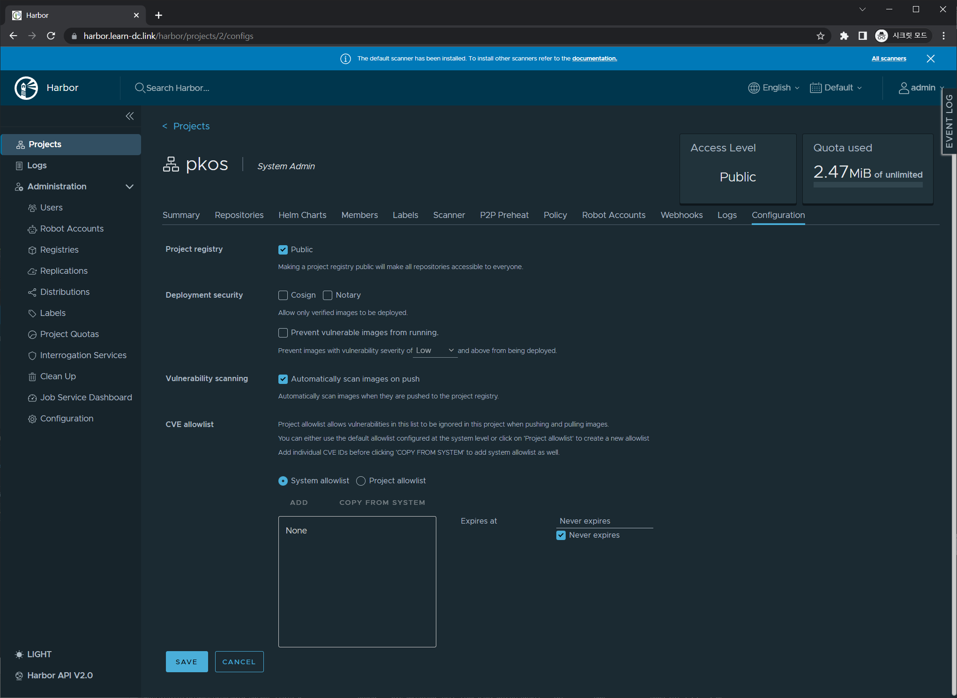

Slide 41
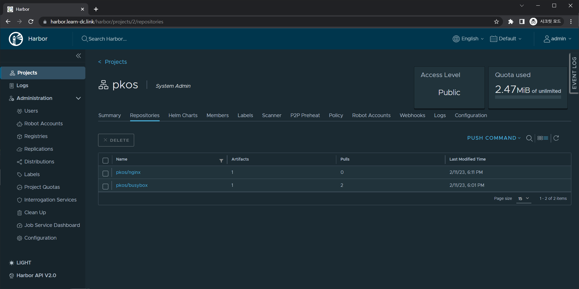

Slide 42
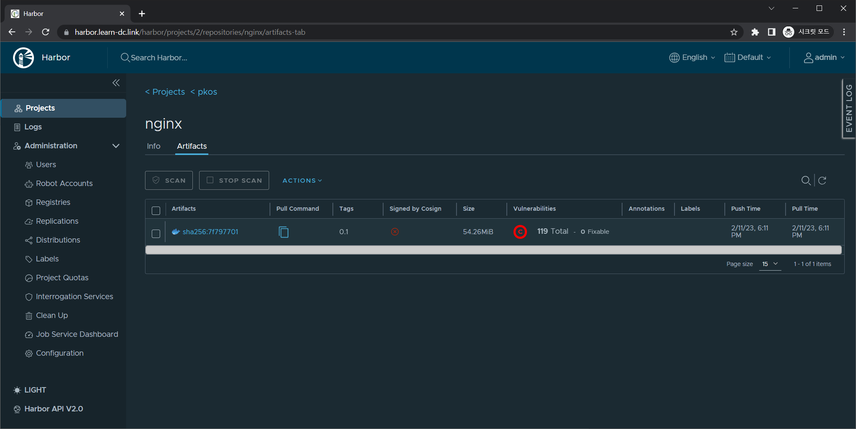

Slide 43
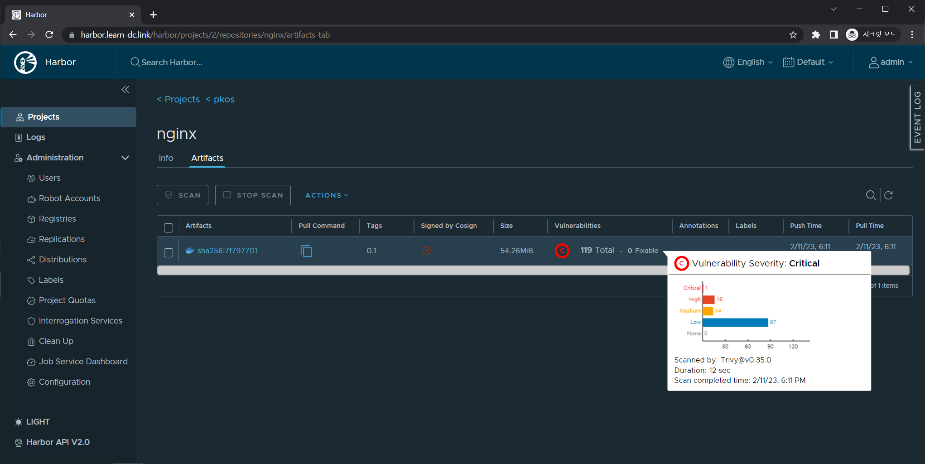

Slide 46
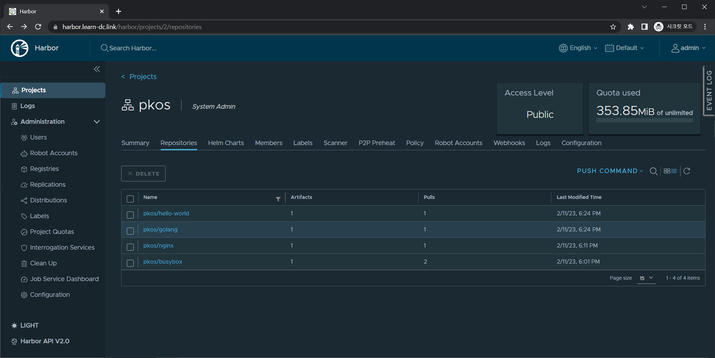

Slide 47
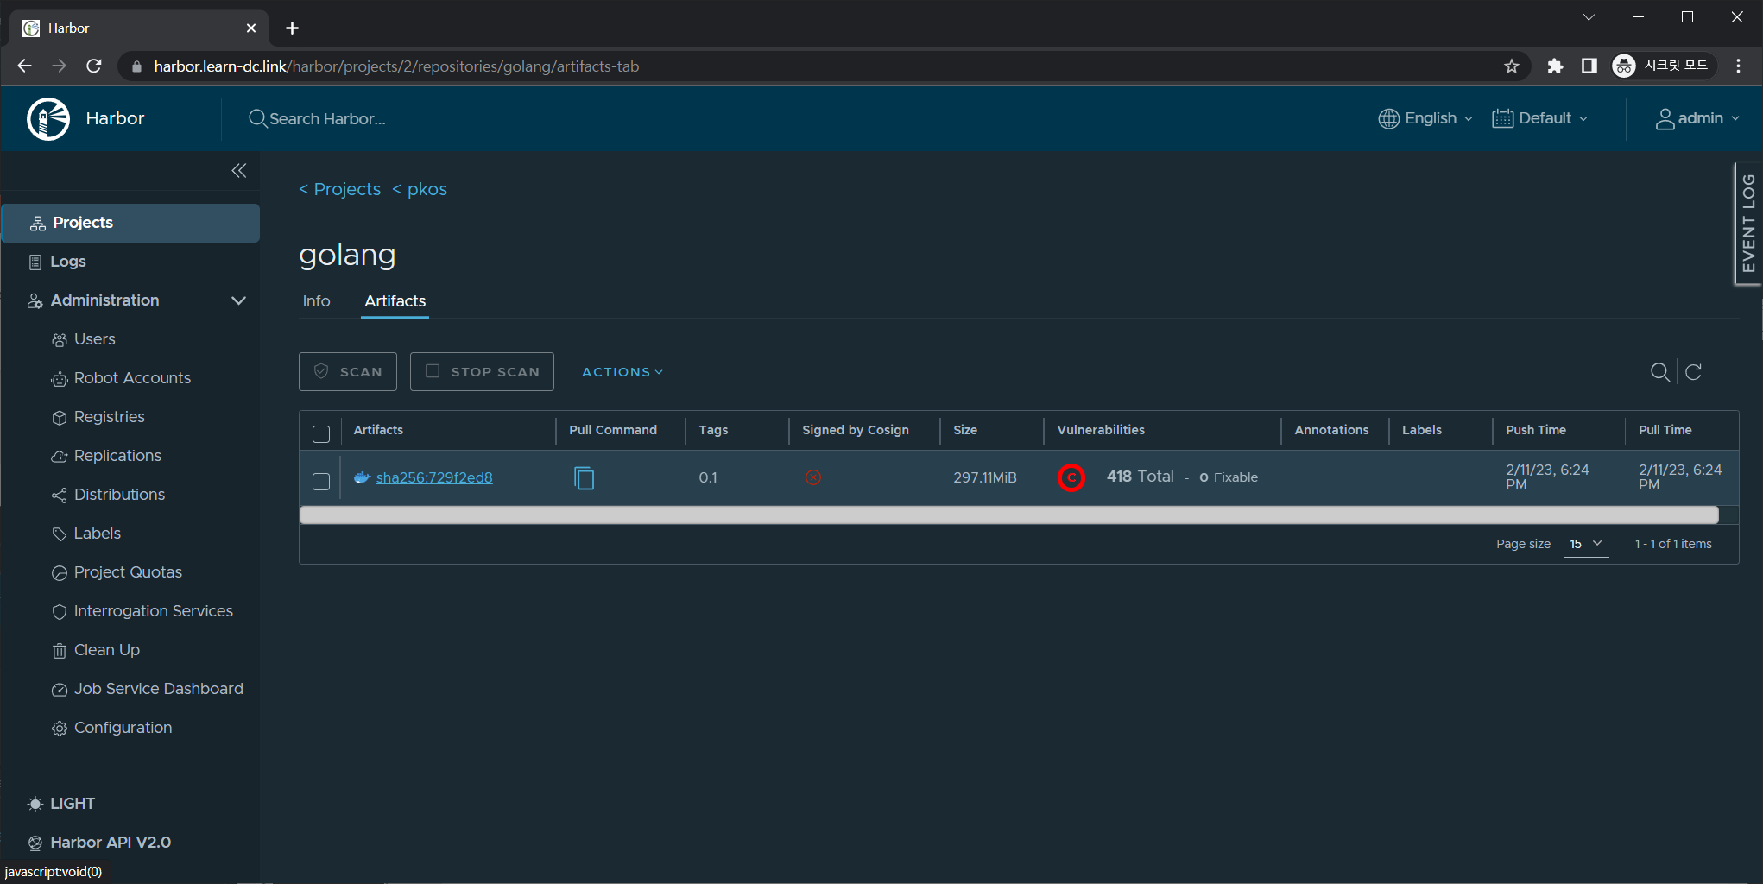

Slide 48
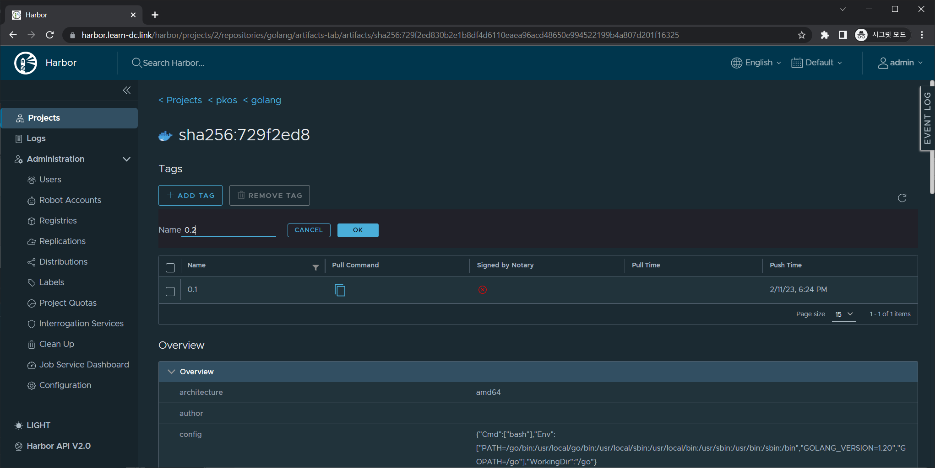

Slide 49
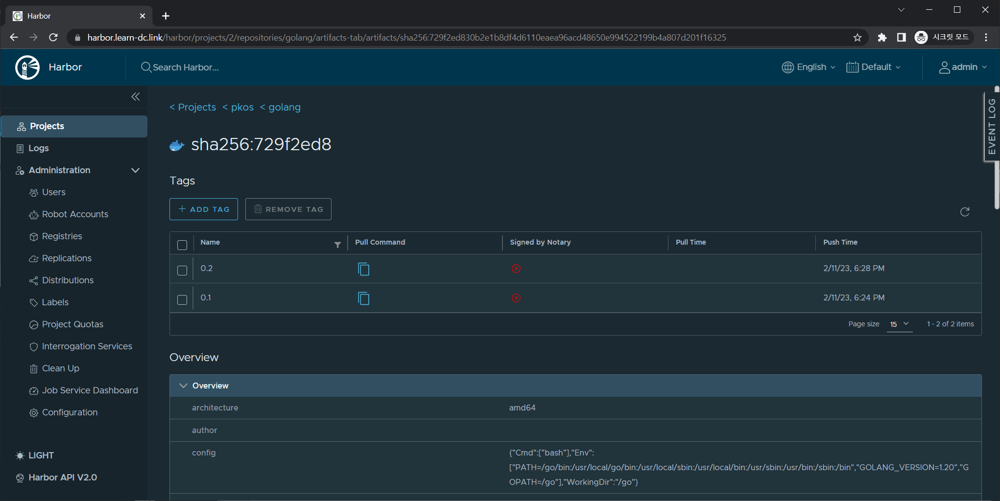

Slide 54
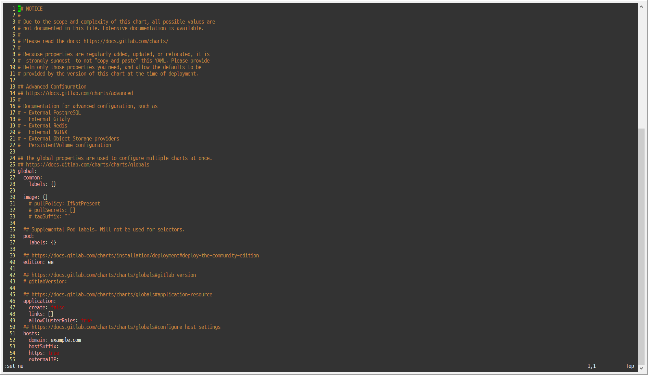
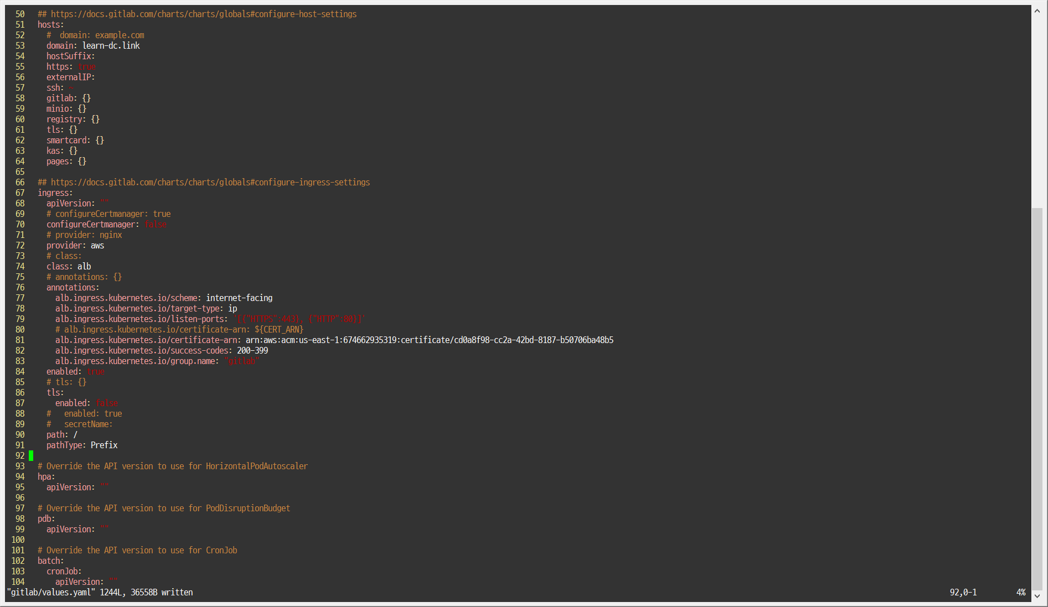

Slide 55
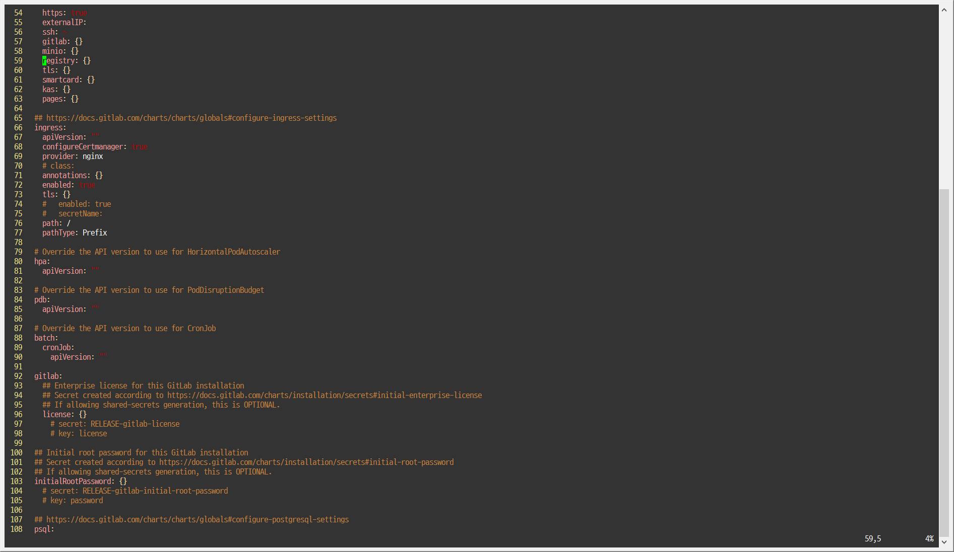

Slide 56
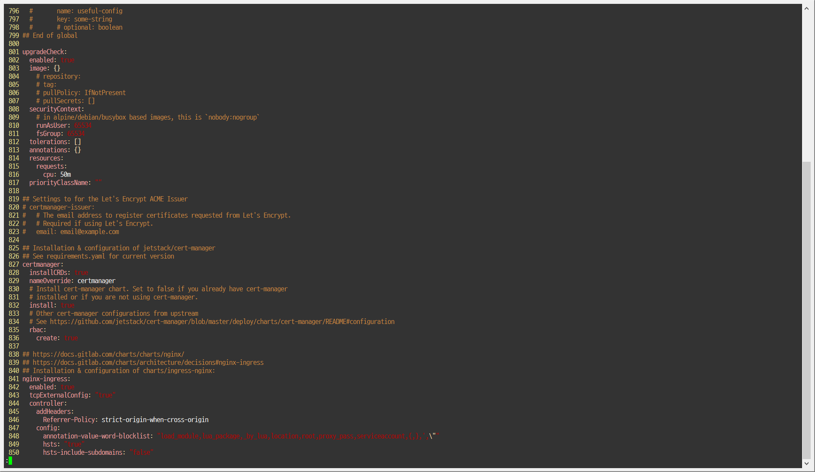
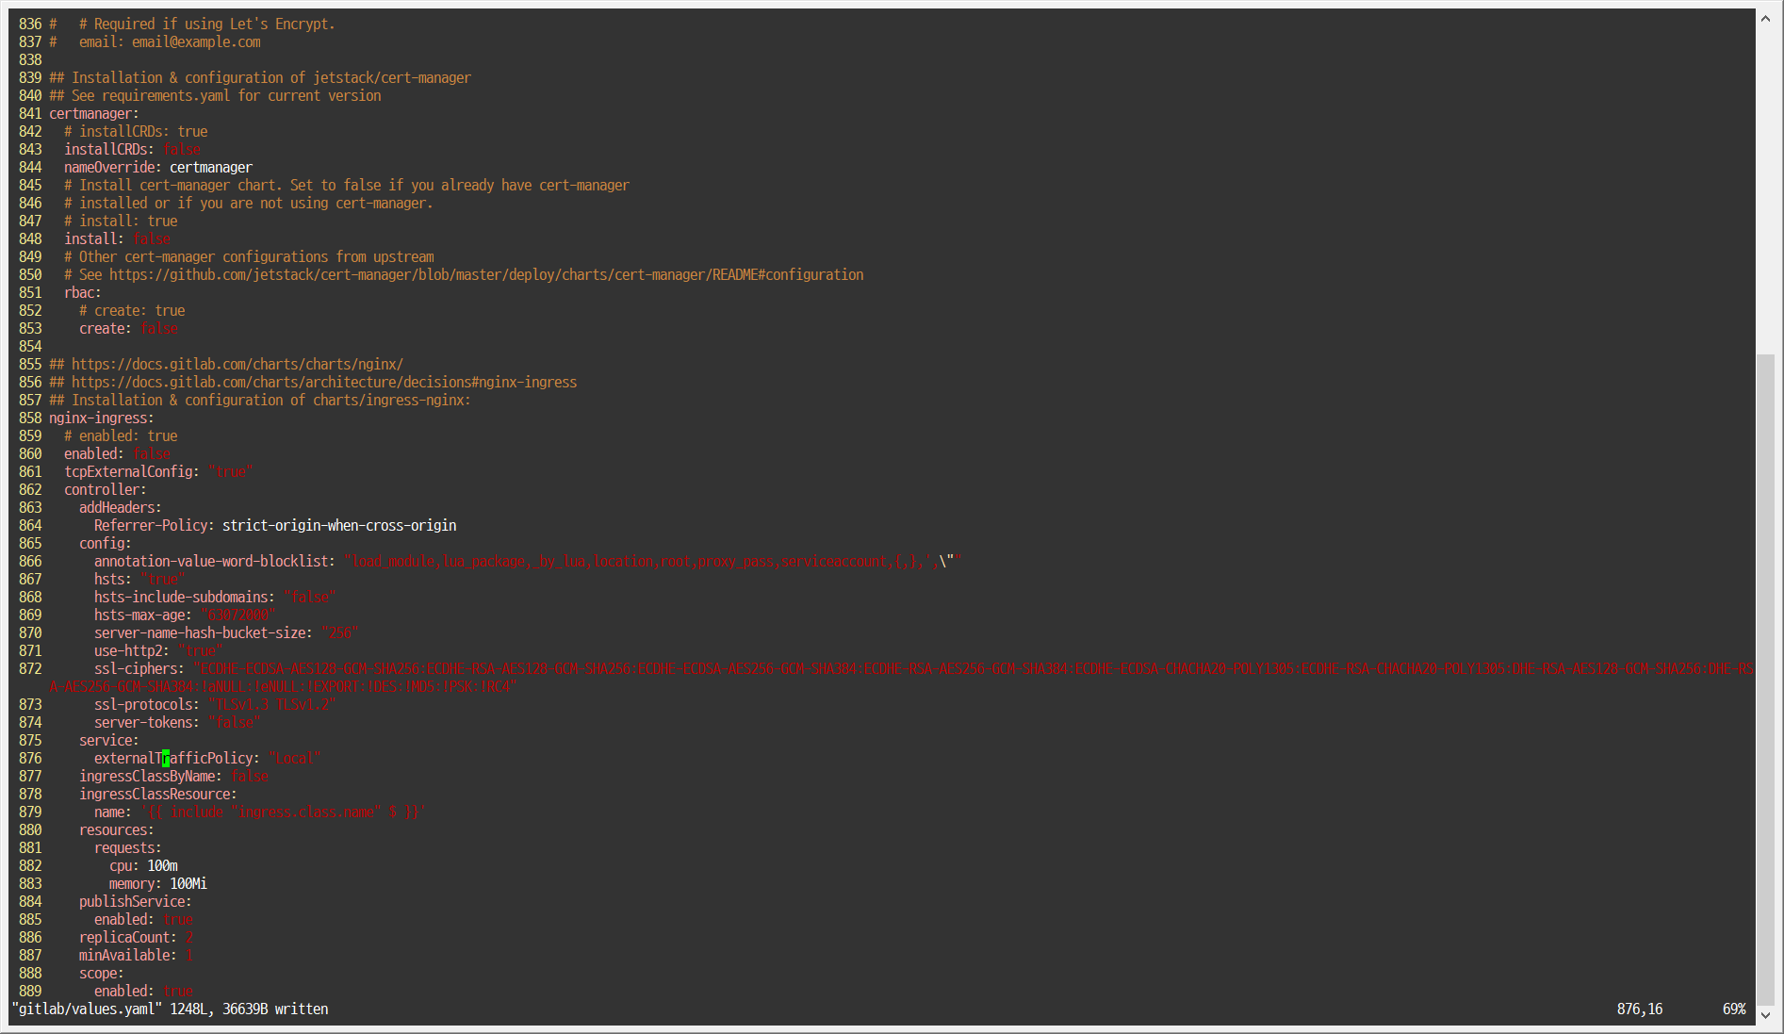

Slide 57
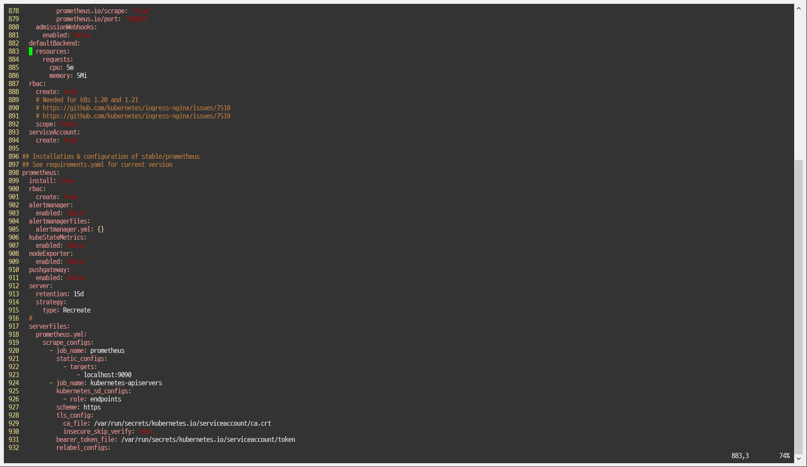
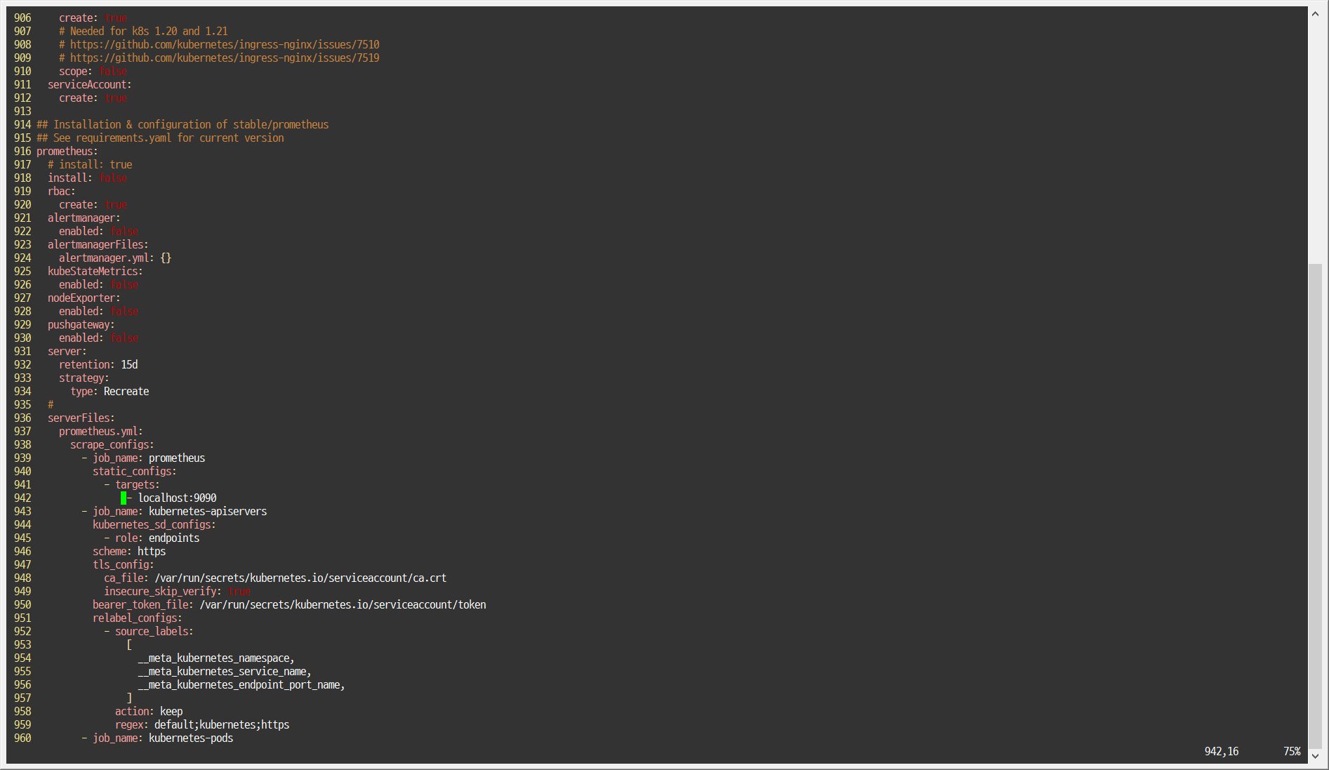

Slide 58
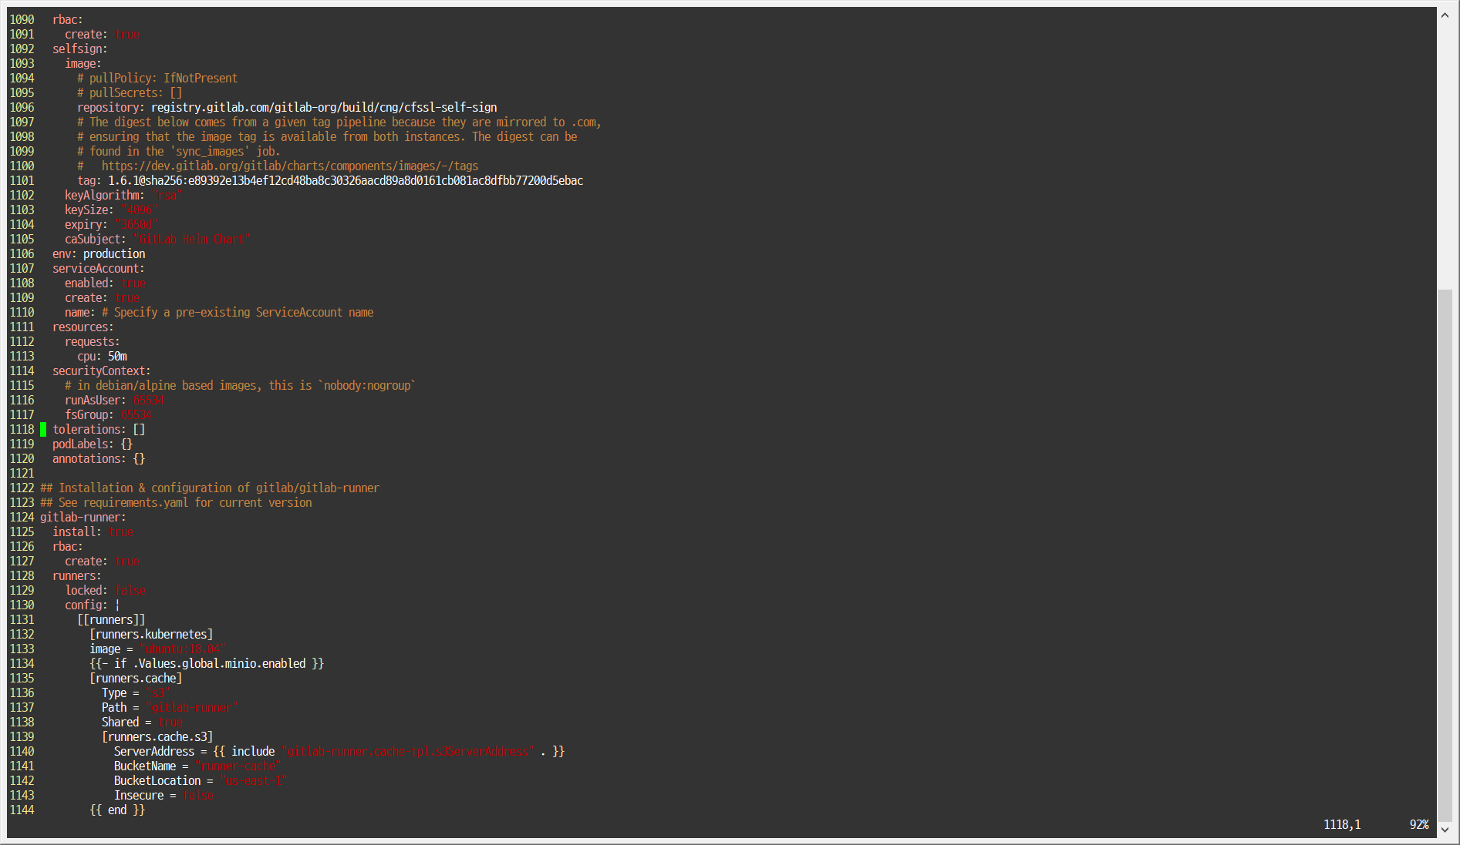
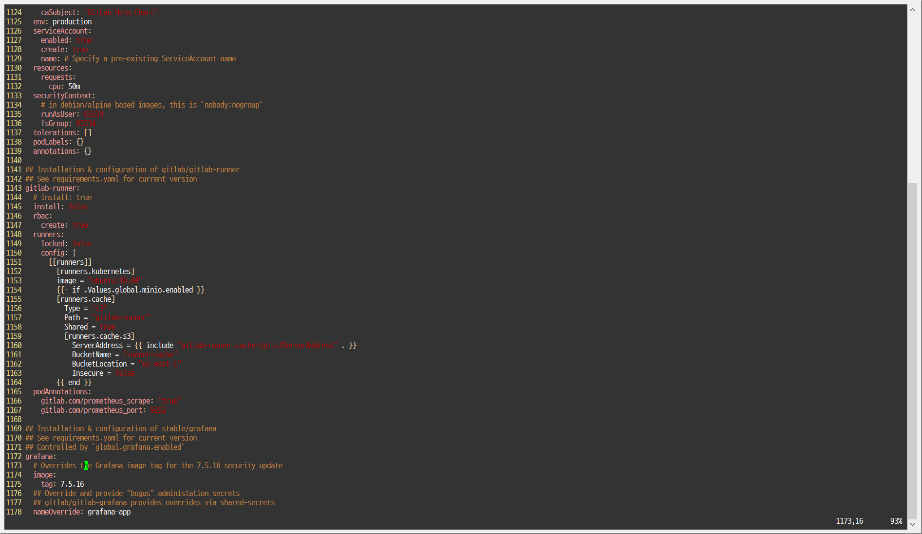

Slide 62
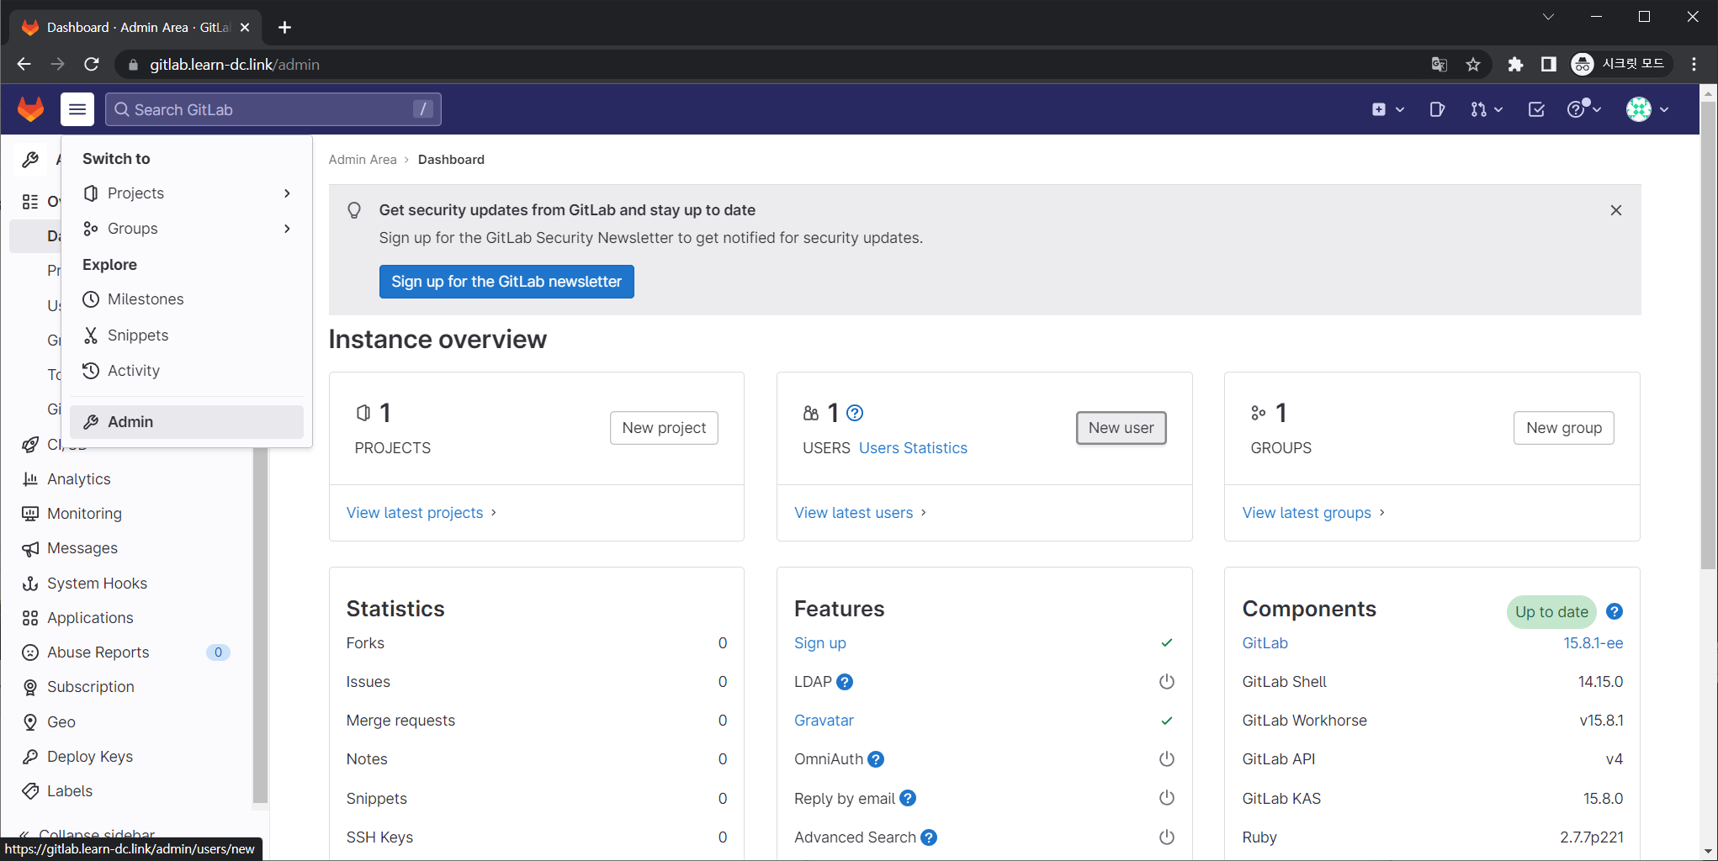

Slide 63
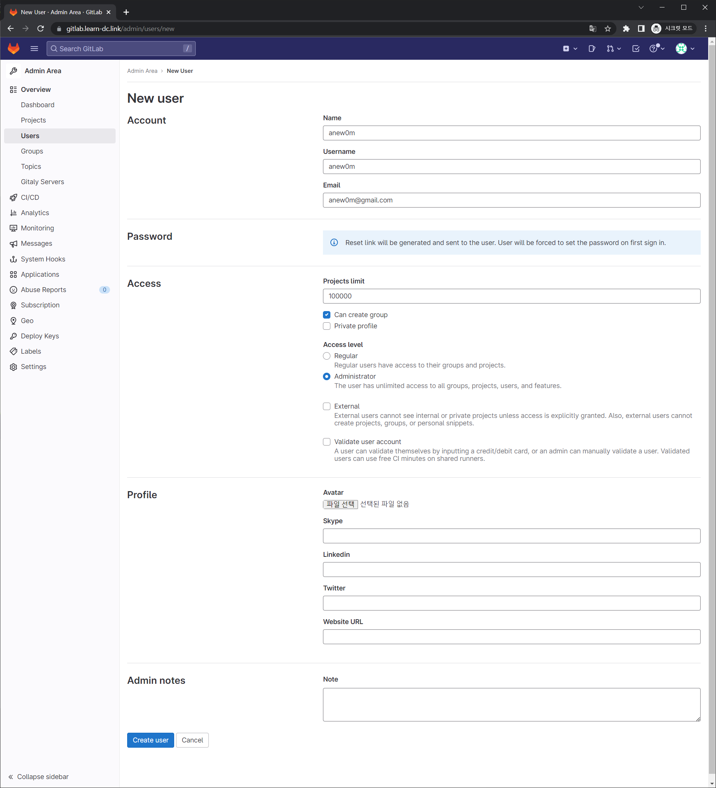

Slide 64
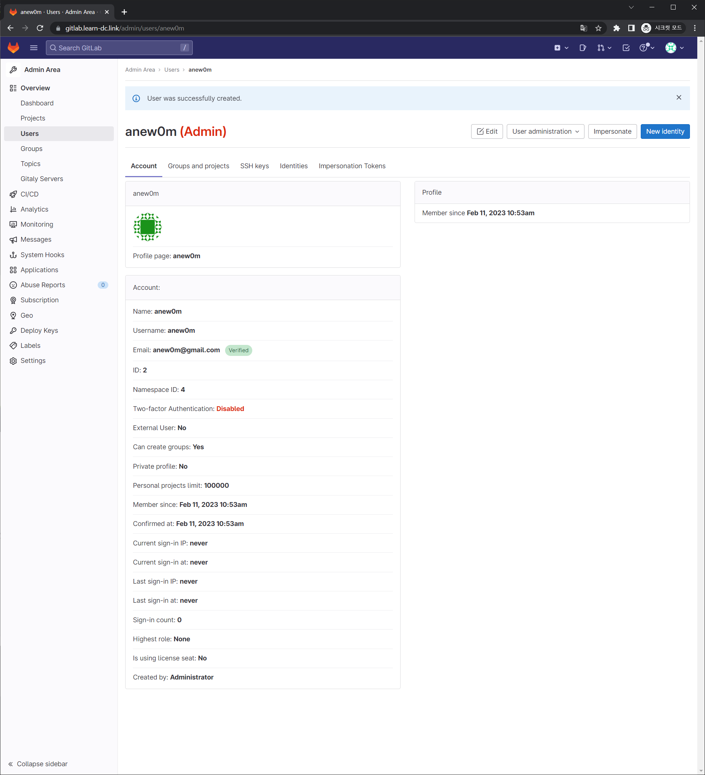

Slide 65
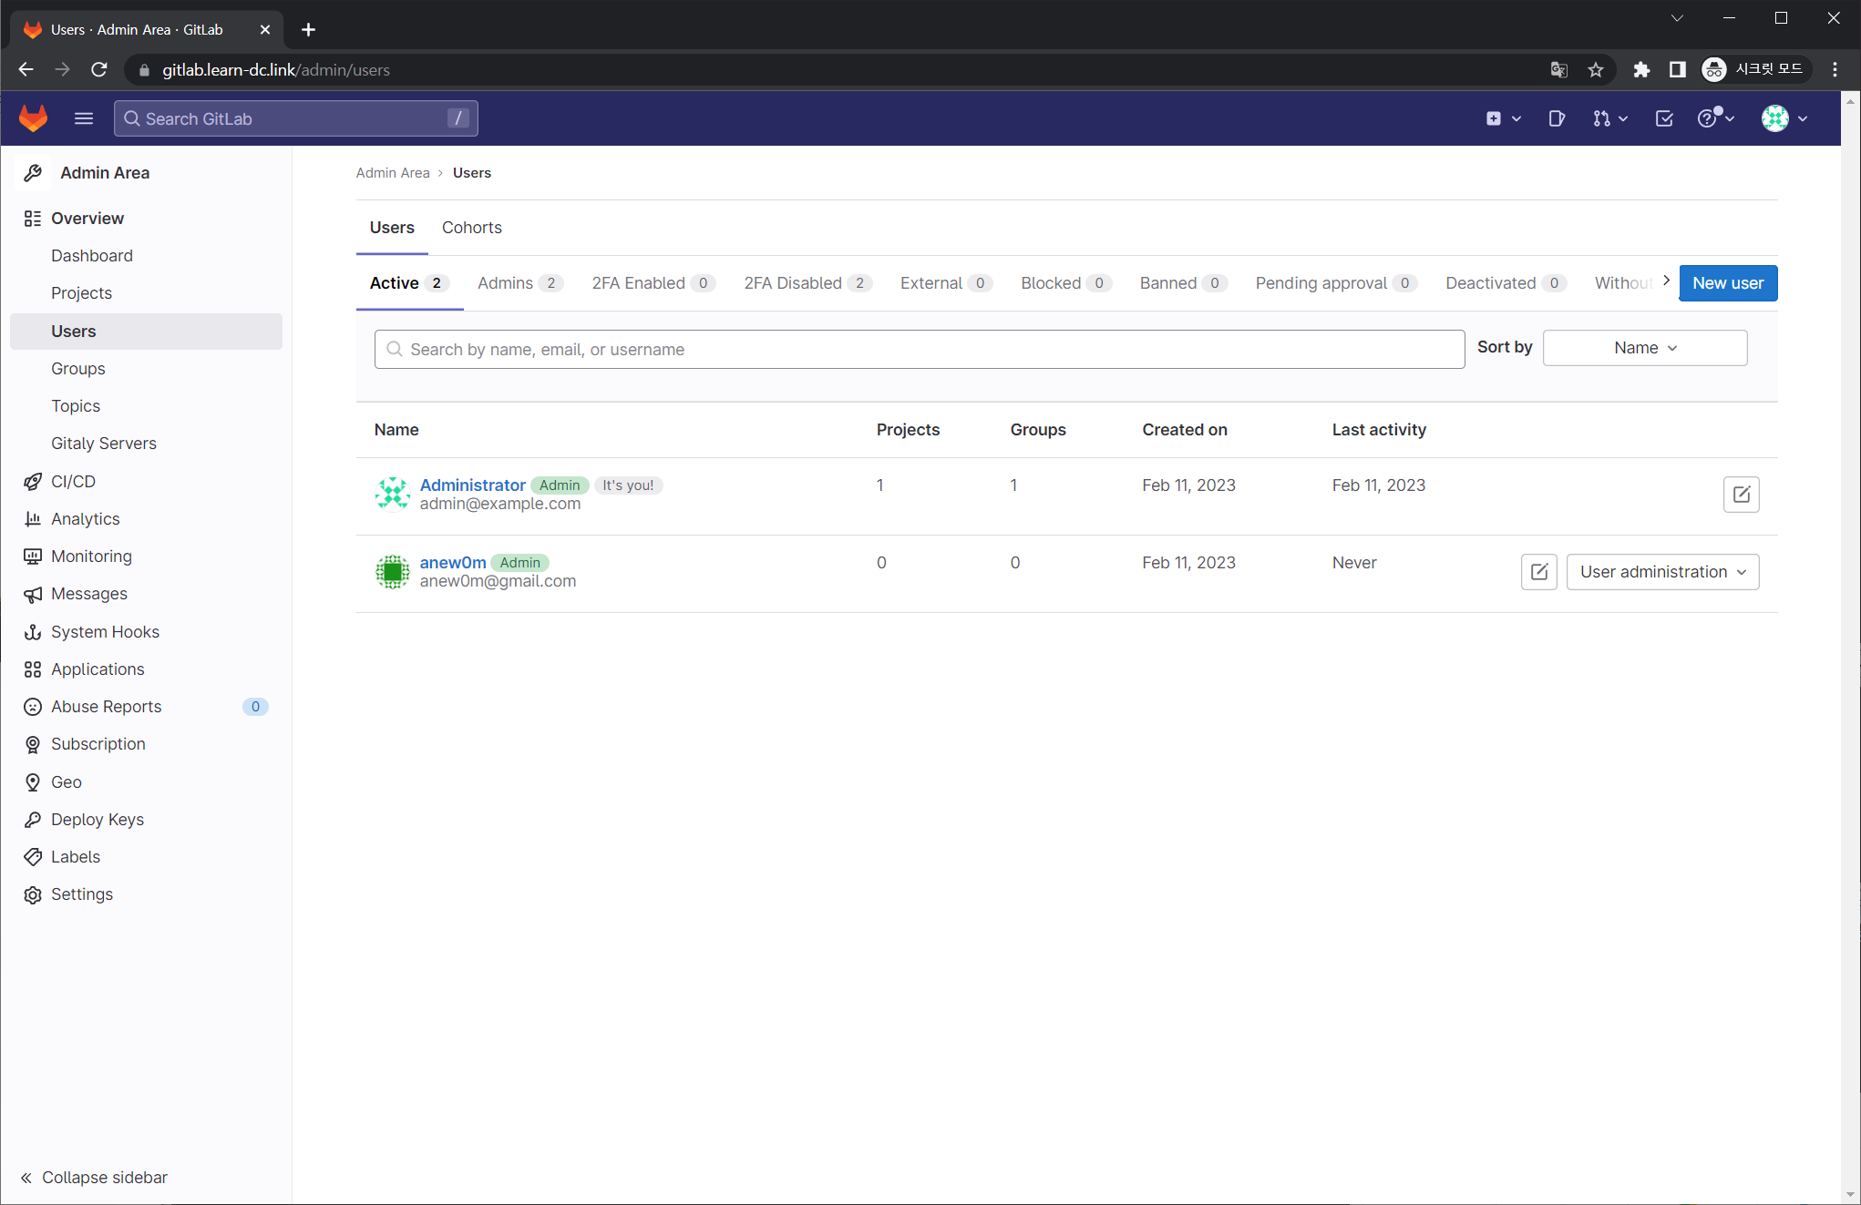

Slide 66
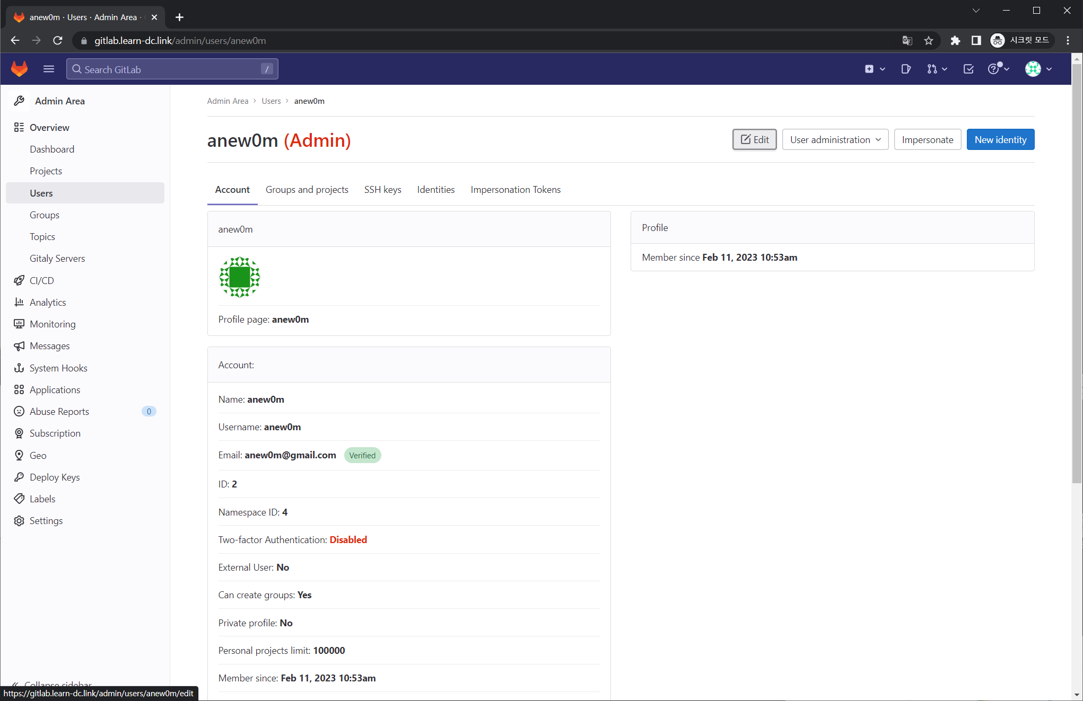
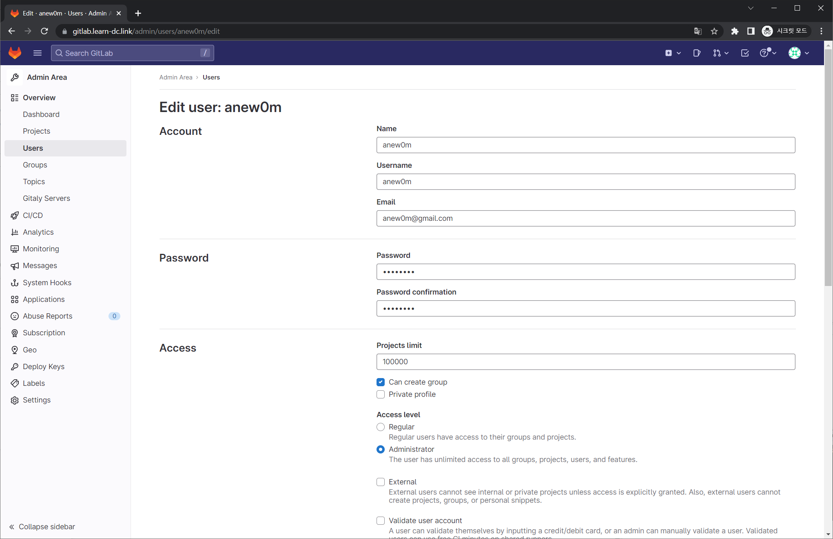
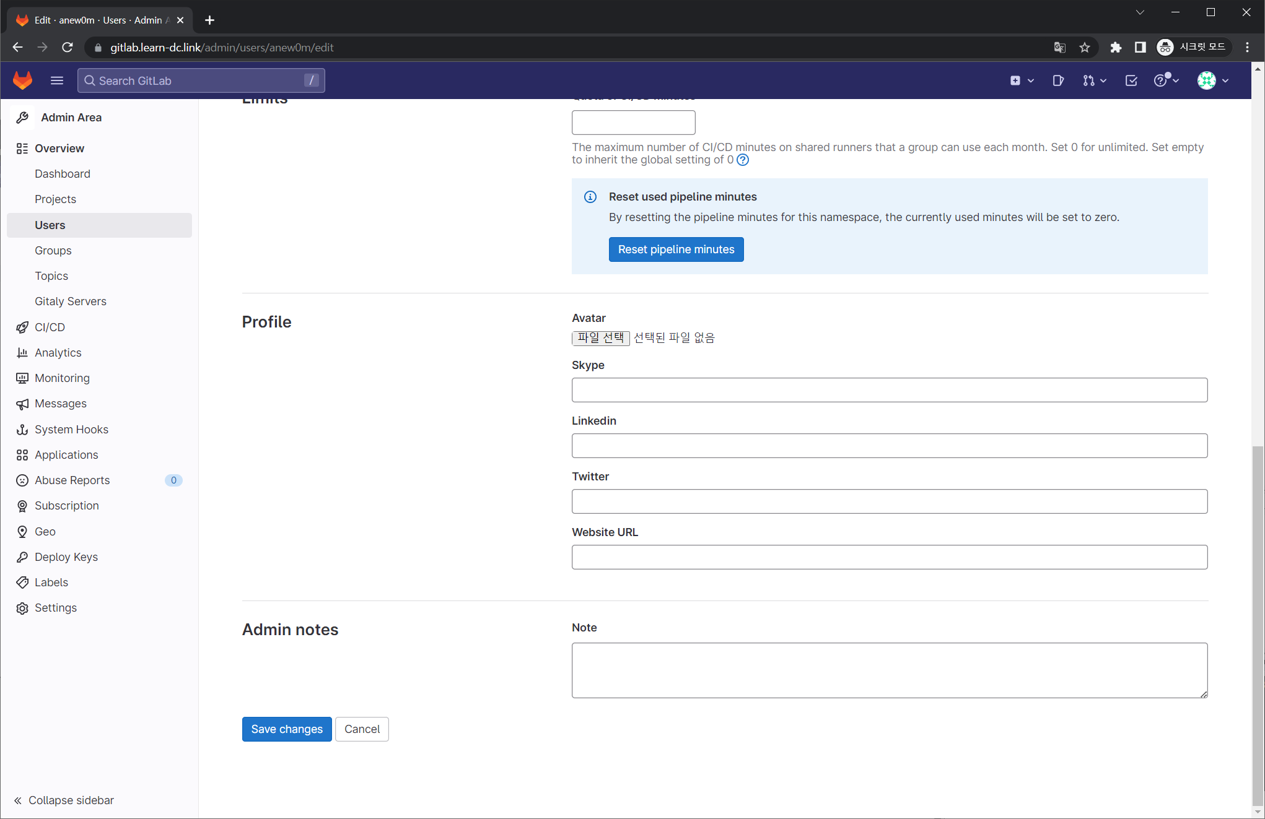

Slide 67



Slide 68


Slide 70


Slide 71


Slide 72


Slide 73


Slide 74


Slide 76


Slide 77


Slide 78


Slide 79


Slide 81


Slide 83


Slide 84


Slide 86



Slide 88


Slide 89


Slide 91


Slide 92


Slide 94



Slide 96



Slide 98


Slide 100


Slide 101


Slide 103


Slide 105



Slide 107



Slide 108


Slide 109


